Slide 1
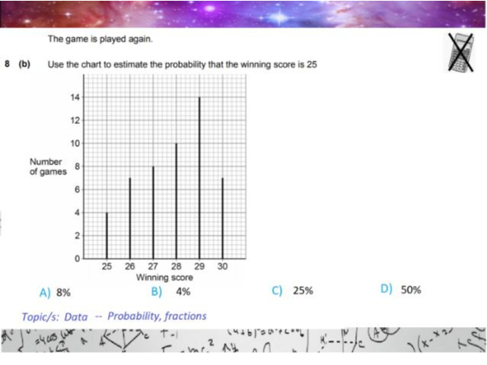
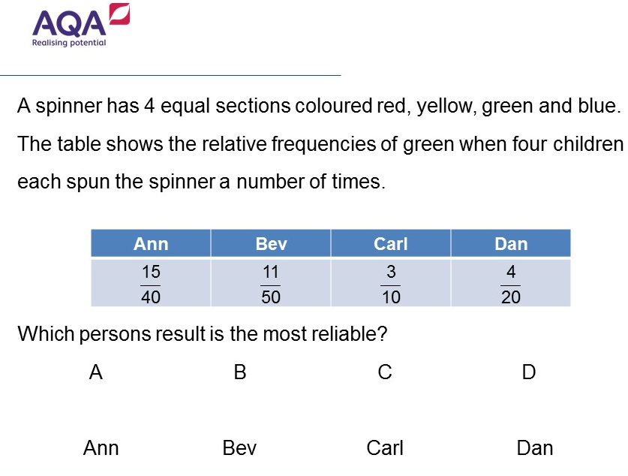
Worst answered question?
Most common wrong answer?

Slide 2
ANSWERS

Slide 3
Worst answered question?

Slide 4

B
They have assumed the total is 100.

Slide 5
D
The have gone for the closest to the theatrical probably rather then choosing the most spins.

