Slide 1
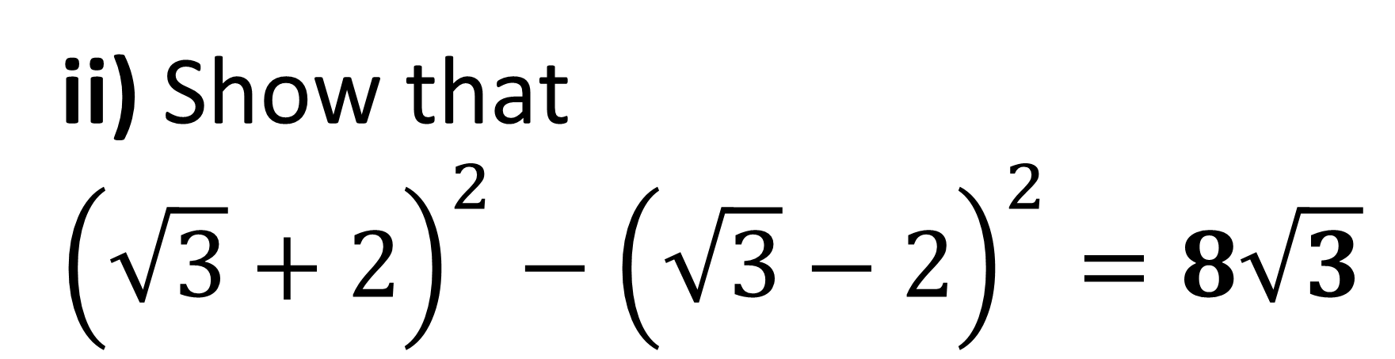
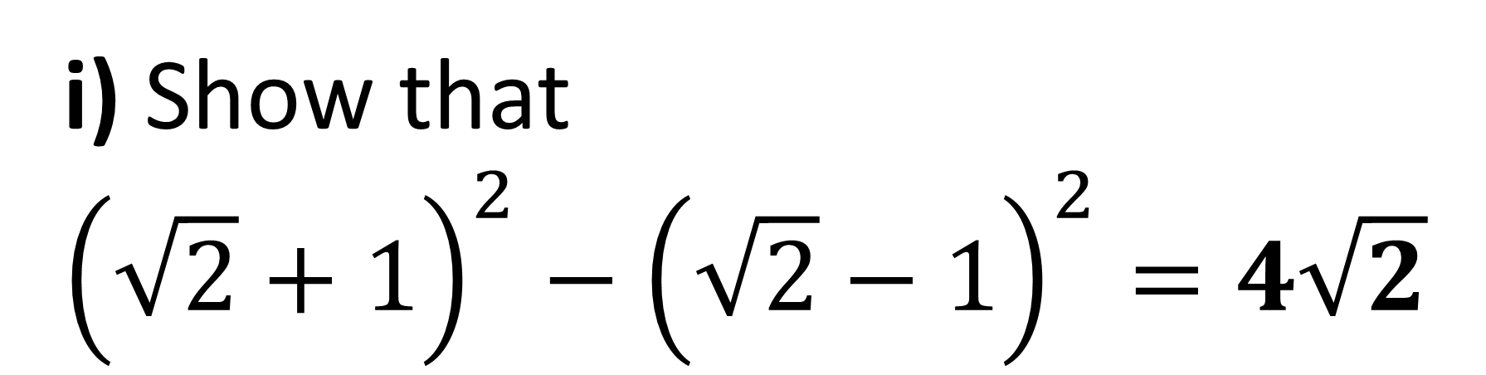
i) $\text{Show} \text{that}$
$${\left(\sqrt{2}+1\right)}^{2}−{\left(\sqrt{2}−1\right)}^{2}=4\sqrt{2}$$
ii) $\text{Show} \text{that}$
$${\left(\sqrt{3}+2\right)}^{2}−{\left(\sqrt{3}−2\right)}^{2}=8\sqrt{3}$$

Slide 2
ANSWERS

Slide 3
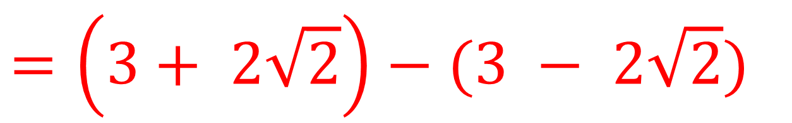
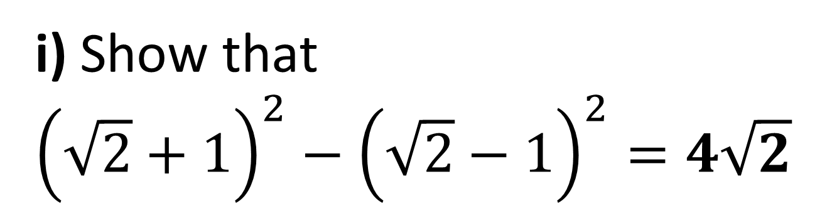
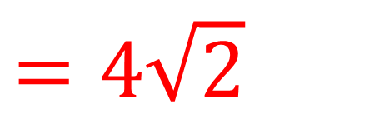
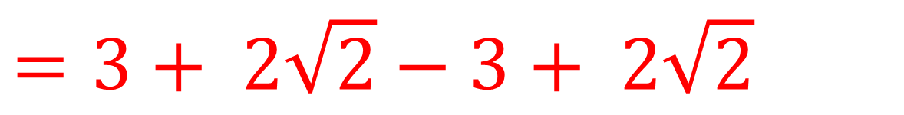
i) $\text{Show} \text{that}$
$${\left(\sqrt{2}+1\right)}^{2}−{\left(\sqrt{2}−1\right)}^{2}=4\sqrt{2}$$
$$=\left(3+ 2\sqrt{2}\right)−(3 − 2\sqrt{2})$$
$$=3+ 2\sqrt{2}−3+ 2\sqrt{2}$$
$$=4\sqrt{2}$$

Slide 4
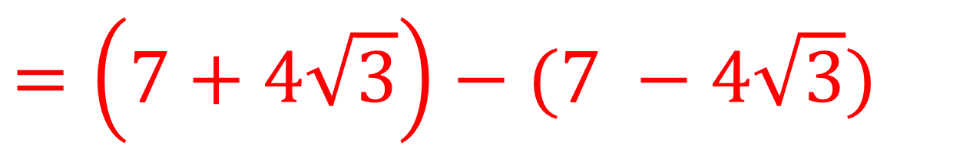
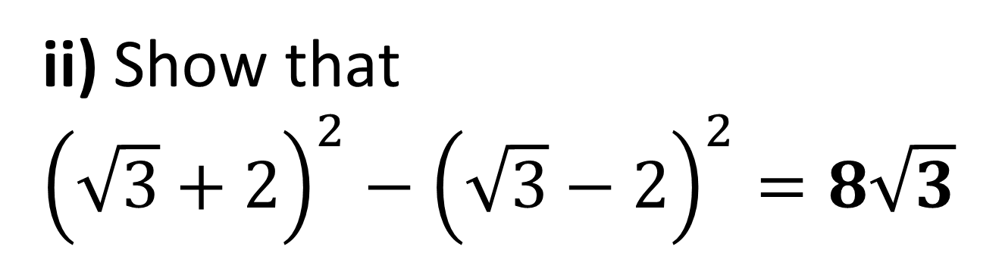
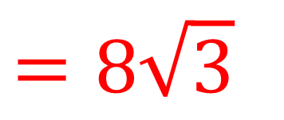
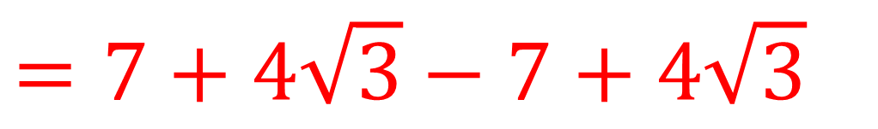
ii) $\text{Show} \text{that}$
$${\left(\sqrt{3}+2\right)}^{2}−{\left(\sqrt{3}−2\right)}^{2}=8\sqrt{3}$$
$$=\left(7+4\sqrt{3}\right)−(7 −4\sqrt{3})$$
$$=7+4\sqrt{3}−7+4\sqrt{3}$$
$$=8\sqrt{3}$$

