Slide 1
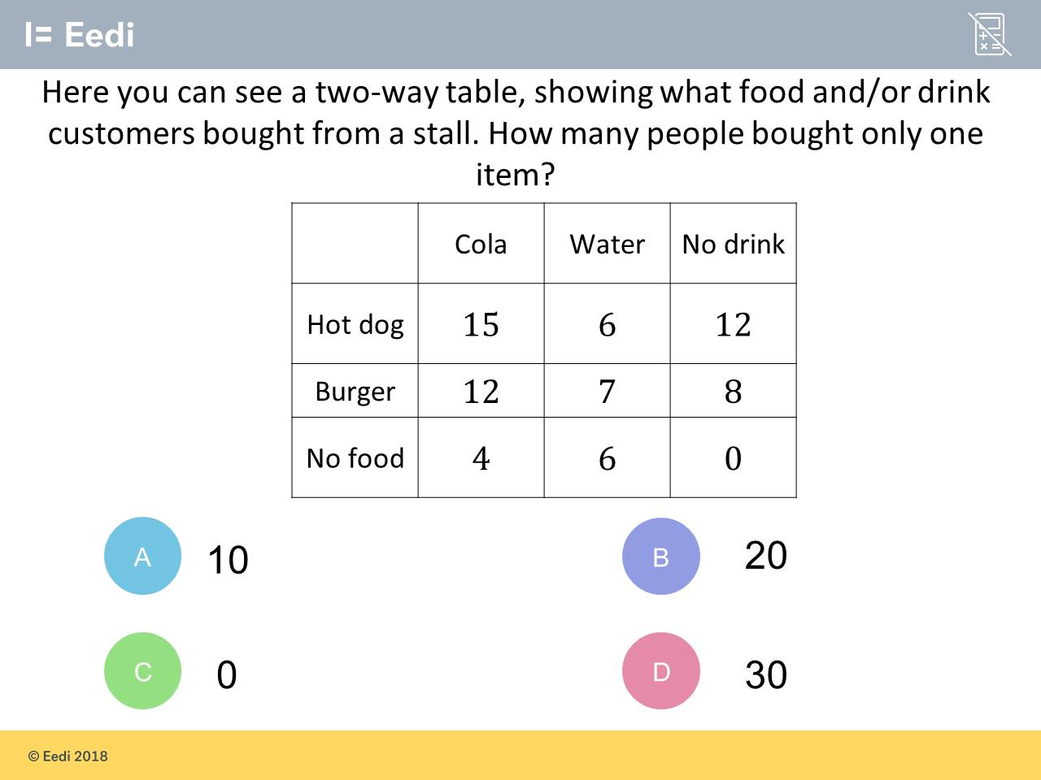
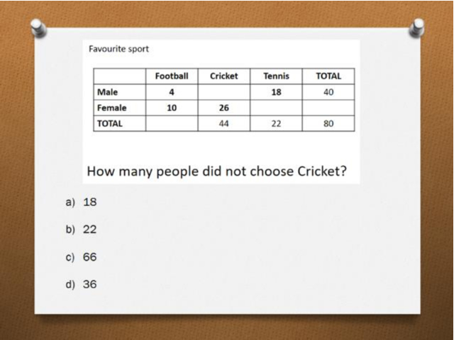
Worst answered question?
Most common wrong answer?

Slide 2
ANSWERS

Slide 3
Worst answered question?

Slide 4
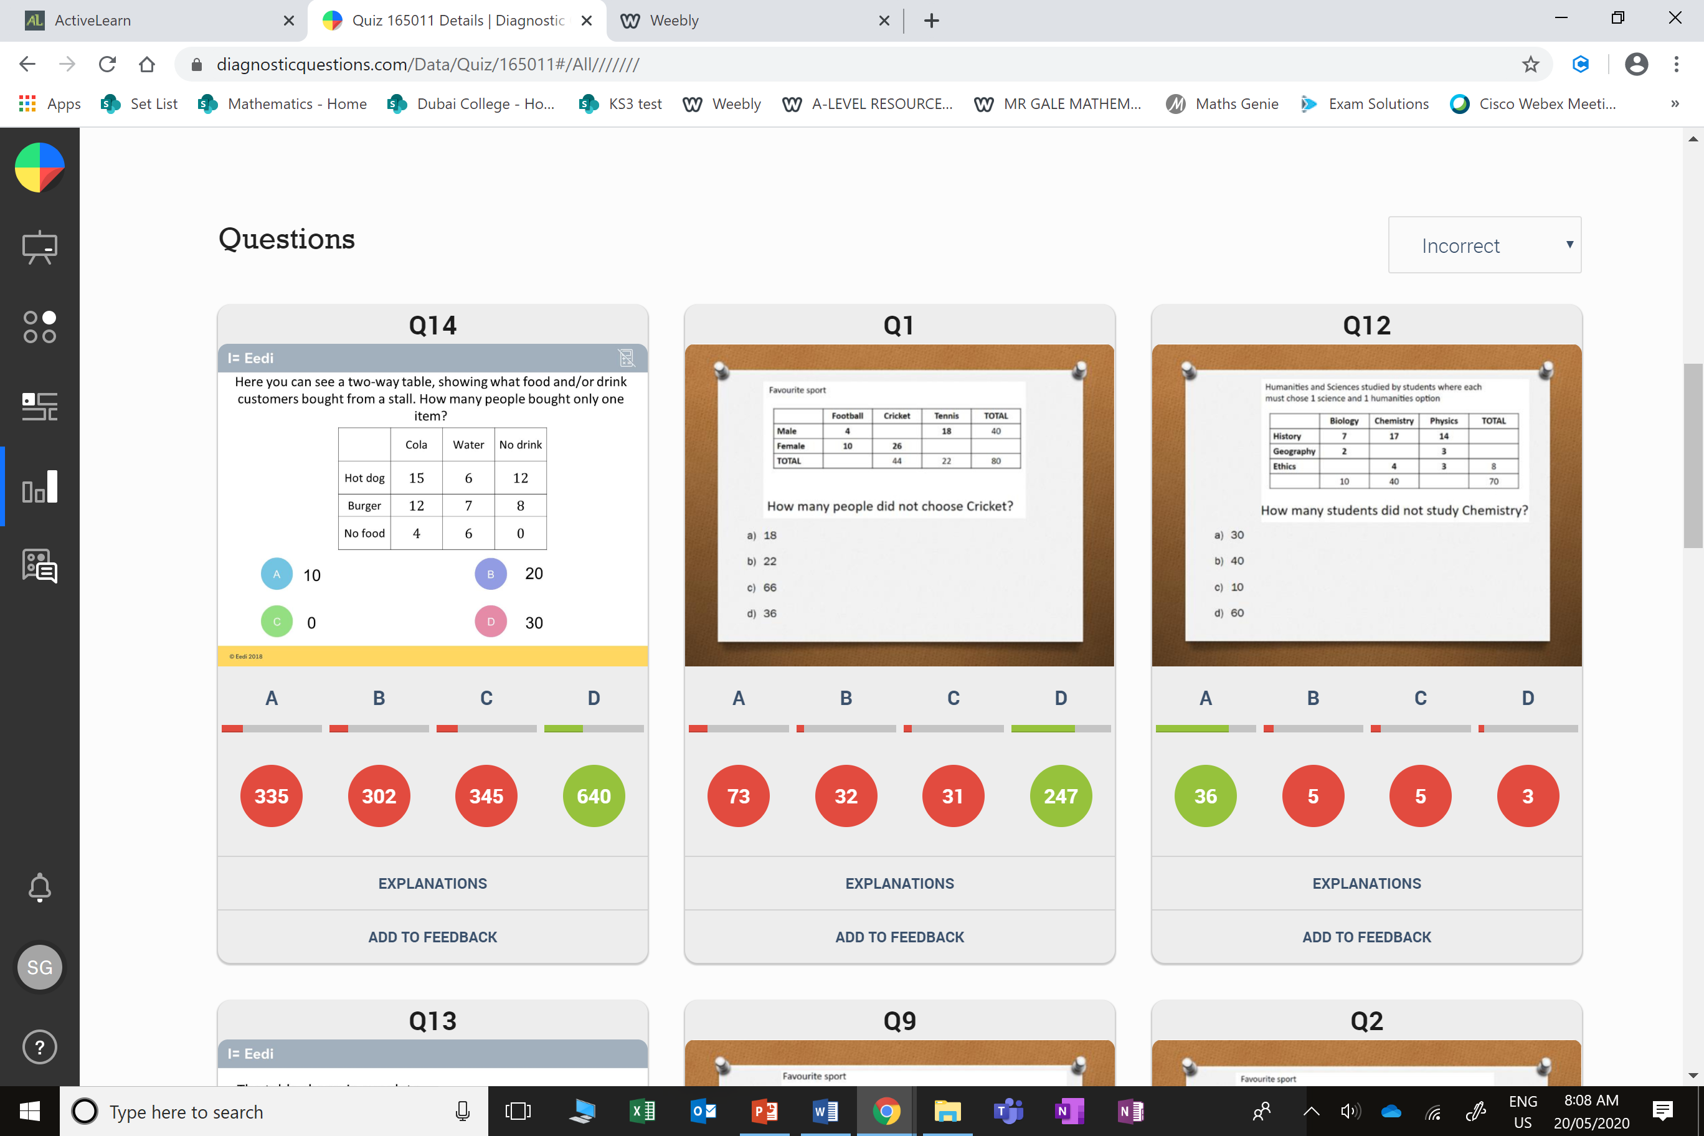
C
The student has found the number of people who ordered nothing.

Slide 5
A
They found the number of males who choose cricket.

