Slide 1
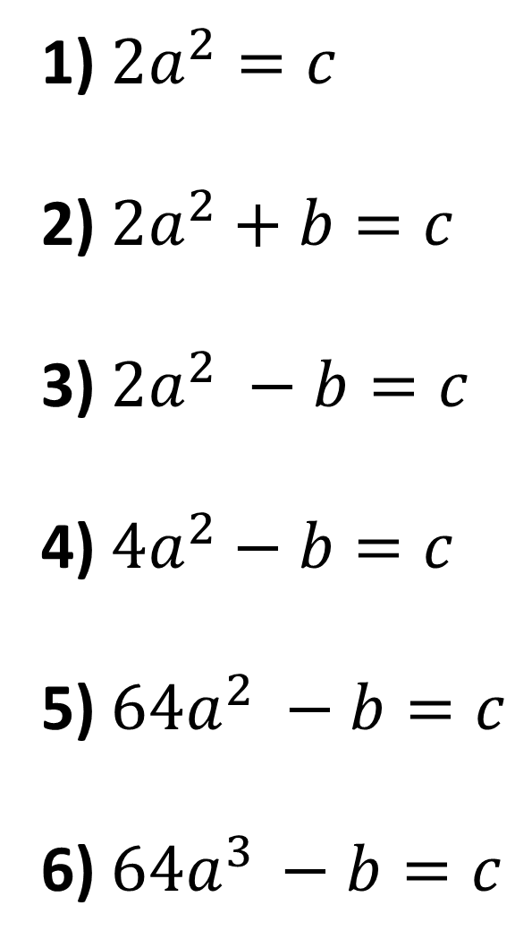
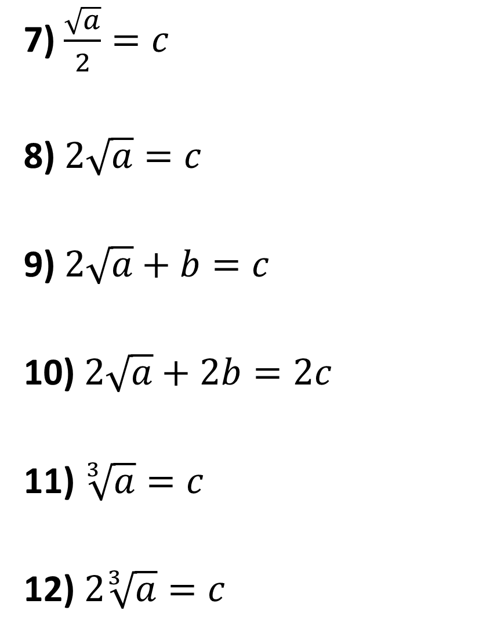
Make 𝑎 the subject:
7) $\frac{\sqrt{a}}{2}=c$
8) $2\sqrt{a}=c$
9) $2\sqrt{a}+b=c$
10) $2\sqrt{a}+2b=2c$
11) $\sqrt[3]{a}=c$
12) $2\sqrt[3]{a}=c$
1) $2a^{2}=c$
2) ${2a}^{2}+b=c$
3) ${2a}^{2} −b=c$
4) ${4a}^{2}−b=c$
5) ${64a}^{2} −b=c$
6) $64a^{3 }−b=c$

Slide 2
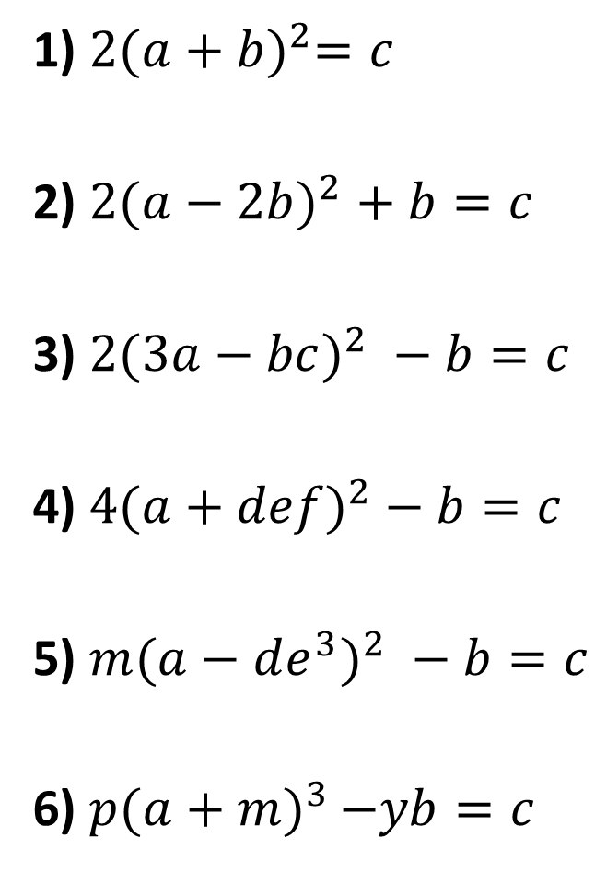
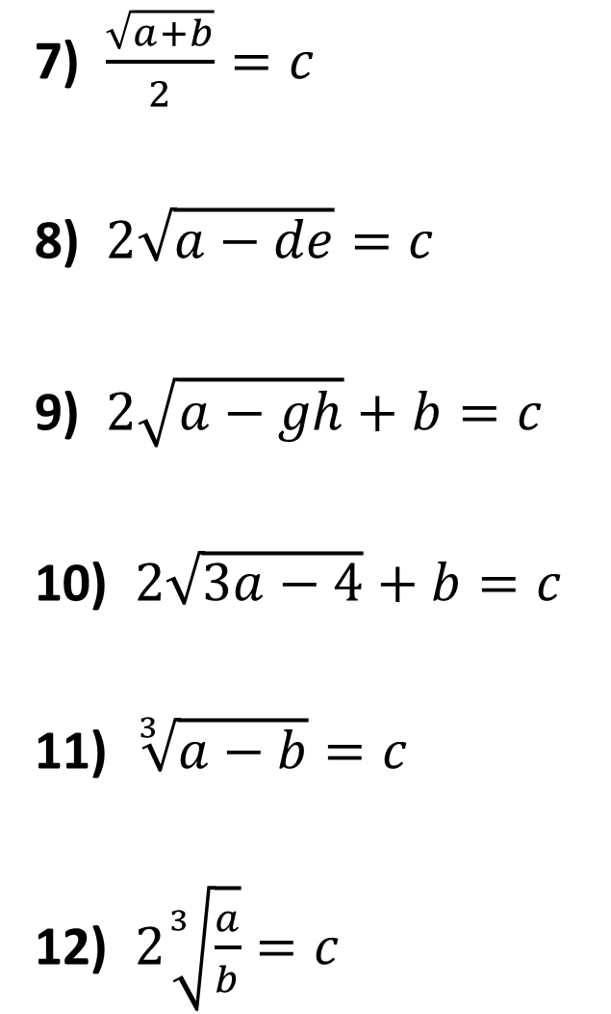
Make 𝑎 the subject:
7) $\frac{\sqrt{a+b}}{2}=c$
8) $2\sqrt{a−de}=c$
9) $2\sqrt{a−gh}+b=c$
10) $2\sqrt{3a−4}+b=c$
11) $\sqrt[3]{a−b}=c$
12) $2\sqrt[3]{\frac{a}{b}}=c$
1) $2{(a+b)}^{2}=c$
2) ${2(a−2b)}^{2}+b=c$
3) ${2(3a−bc)}^{2} −b=c$
4) ${4(a+def)}^{2}−b=c$
5) ${m(a−de^{3})}^{2} −b=c$
6) $p{(a+m)}^{3 }−yb=c$

Slide 3
ANSWERS

Slide 4
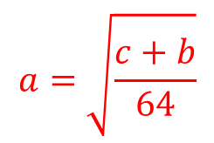
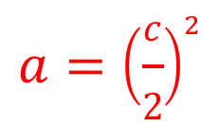
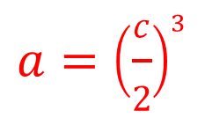
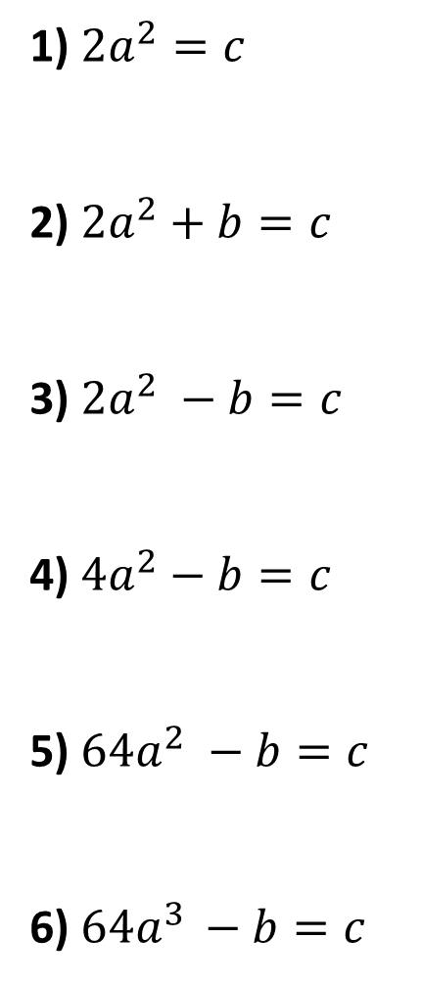
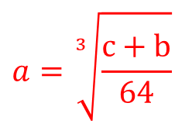

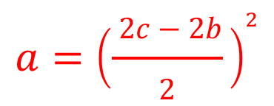
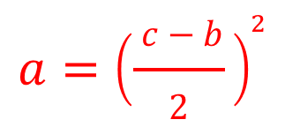
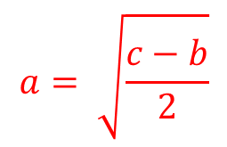
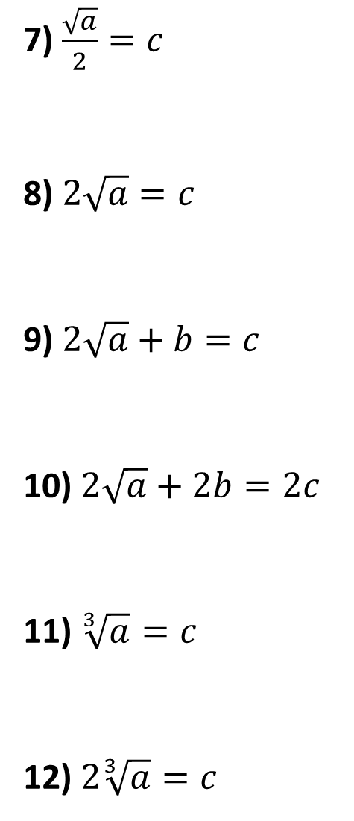
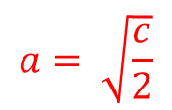

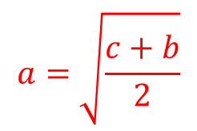
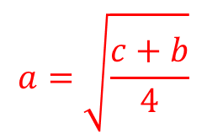

Make 𝑎 the subject:
7) $\frac{\sqrt{a}}{2}=c$
8) $2\sqrt{a}=c$
9) $2\sqrt{a}+b=c$
10) $2\sqrt{a}+2b=2c$
11) $\sqrt[3]{a}=c$
12) $2\sqrt[3]{a}=c$
$$a={(2c)}^{2}$$
$$= 4c^{2}$$
$$a= \sqrt{\frac{c}{2}}$$
1) $2a^{2}=c$
2) ${2a}^{2}+b=c$
3) ${2a}^{2} −b=c$
4) ${4a}^{2}−b=c$
5) ${64a}^{2} −b=c$
6) $64a^{3 }−b=c$
$$a={\left(\frac{c}{2}\right)}^{2}$$
$$a= \sqrt{\frac{c−b}{2}}$$
$$a={\left(\frac{ c−b}{2} \right)}^{2}$$
$$a=\sqrt{\frac{c+b}{2}}$$
$$a=\sqrt{\frac{c+b}{4}}$$
$$a={\left(\frac{ 2c−2b}{2} \right)}^{2}$$
$$a=\sqrt{\frac{c+b}{64}}$$
$$a= c^{3}$$
$$a=\sqrt[3]{\frac{c+b}{64}}$$
$$a={\left(\frac{c}{2}\right)}^{3}$$

Slide 5
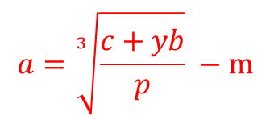
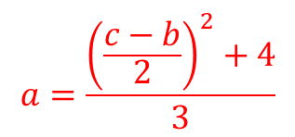
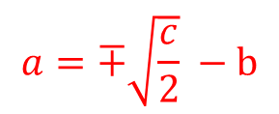
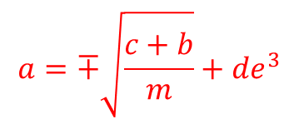
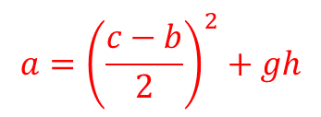
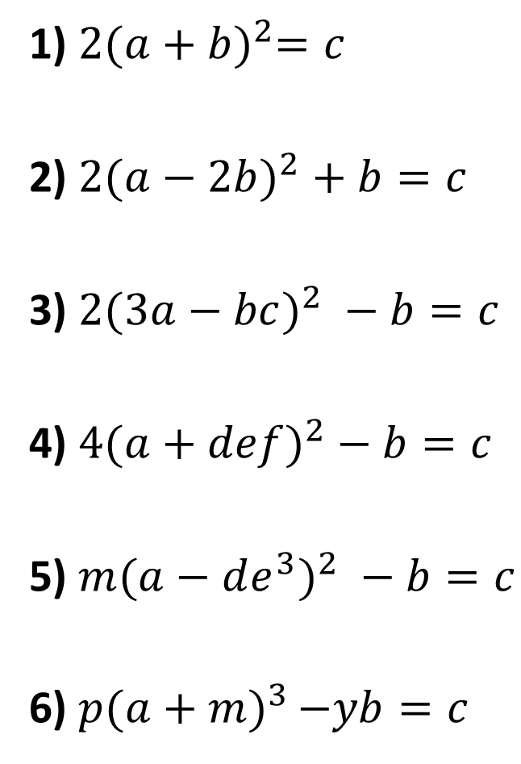
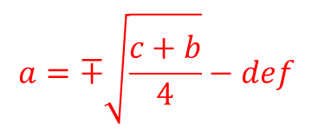
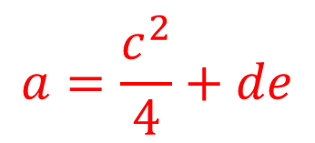
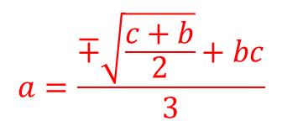
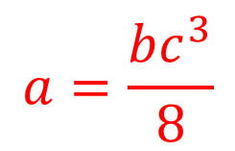

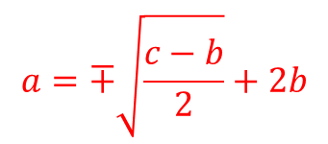
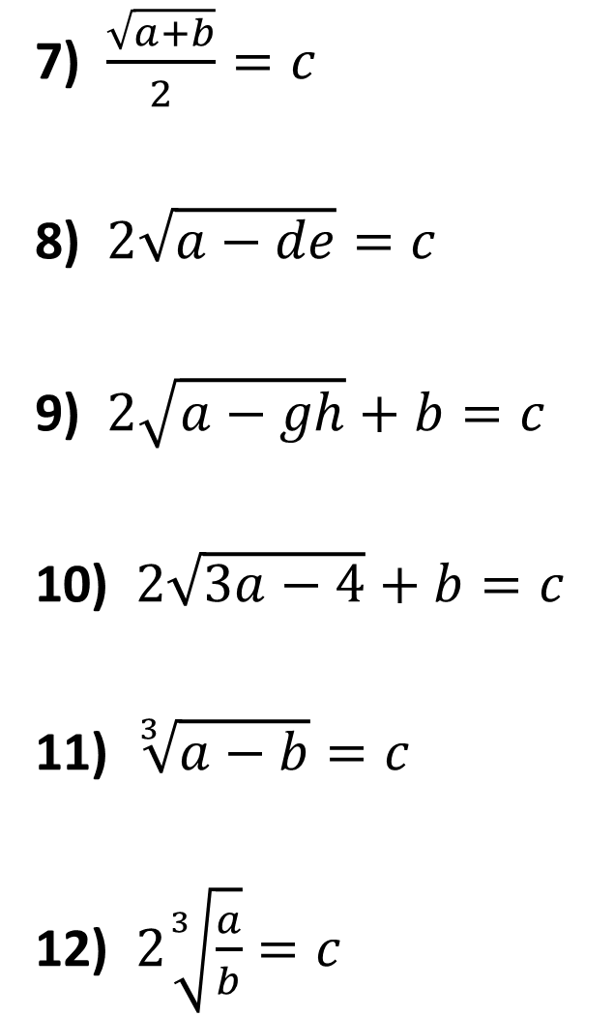

Make 𝑎 the subject:
7) $\frac{\sqrt{a+b}}{2}=c$
8) $2\sqrt{a−de}=c$
9) $2\sqrt{a−gh}+b=c$
10) $2\sqrt{3a−4}+b=c$
11) $\sqrt[3]{a−b}=c$
12) $2\sqrt[3]{\frac{a}{b}}=c$
$$a=4c^{2}−b$$
$$a=∓\sqrt{\frac{c}{2}} −b$$
1) $2{(a+b)}^{2}=c$
2) ${2(a−2b)}^{2}+b=c$
3) ${2(3a−bc)}^{2} −b=c$
4) ${4(a+def)}^{2}−b=c$
5) ${m(a−de^{3})}^{2} −b=c$
6) $p{(a+m)}^{3 }−yb=c$
$$a=\frac{c^{2}}{4}+de$$
$$a=∓\sqrt{\frac{c−b}{2}}+2b$$
$$a=\frac{∓\sqrt{\frac{c+b}{2}}+bc}{3}$$
$$a={\left(\frac{c−b}{2}\right)}^{2}+gh$$
$$a=∓\sqrt{\frac{c+b}{4}}−def$$
$$a=\frac{{\left(\frac{c−b}{2}\right)}^{2}+4}{3}$$
$$a=∓\sqrt{\frac{c+b}{m}}+de^{3}$$
$$a=c^{3}+b$$
$$a=\sqrt[3]{\frac{c+yb}{p}} −m$$
$$a=\frac{bc^{3}}{8}$$

