Slide 1
1) Pete has seven Shetland ponies. They have a mean height of 116cm. Pete buys an eighth pony. The height of this pony is 128cm. Find the mean height of all eight ponies.
2) The mean of eight numbers is 41. The mean of two of the numbers is 29. What is the mean of the other six numbers?
3) There are 12 students in Phil’s Maths group. The mean mark in a test is 76%. In Paul’s group there are only eight students. Their mean mark is 84%. Find the overall mean for the 20 children.
4) The time it took each of Zoe, Peter, Mary and Paul to run a race was recorded. The mean of these times is 12.5 seconds. Harry also ran the race. It took Harry 14.0 seconds to run the race. Work out the combined mean time for all 5 people.
5) Nigel has scored a mean of 18 runs in the last five cricket matches. His mean score must be 20 or more for him to be chosen for the school team. Find the number of runs that he must make in the next match if he is to be chosen for the school team.
6) Annabel recorded her test results in the back of her exercise book.
Maths English Physics Chemistry Biology
88% 85% 77% 79%
Annabel knows the mean of her five tests was 81%. What did she get in Biology?
7) There are 25 students in a class, 10 girls and 15 boys. On one particular night, the mean time spend on homework by the boys was 1.6 hours and the mean time spent on homework by the girls was 2.1 hours. Work out the mean time spent on homework by all the students in the class. Give your answer in hours and minutes.

Slide 2
ANSWERS

Slide 3
1) Pete has seven Shetland ponies.
They have a mean height of 116cm.
Pete buys an eighth pony.
The height of this pony is 128cm.
Find the mean height of all eight ponies.
Seven Ponies
116 = sum ÷ 7
So Sum = 116 x 7 = 812
Eight ponies
812 + 128 = 940
940 ÷ 8 = 117.5

Slide 4
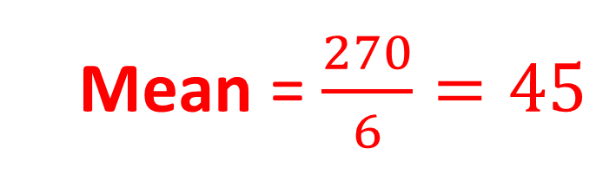
2) The mean of eight numbers is 41.
The mean of two of the numbers is 29.
What is the mean of the other six numbers?
Sum of Eight Numbers
8 x 41 = 328
Sum of Six Numbers
328 – 58 = 270
Sum of two numbers
2 x 29 = 58
Mean = $\frac{270}{6}=45$

Slide 5
3) There are 12 students in Phil’s Maths group.
The mean mark in a test is 76%.
In Paul’s group there are only eight students.
Their mean mark is 84%.
Find the overall mean for the 20 children.
12 Students
S76 x 12 = 912
20 students
912 + 672 = 1584
8 Students
84 x 8 = 672
Mean 1584 ÷ 20 = 79.2

Slide 6
4) The time it took each of Zoe, Peter, Mary and Paul to run a race was recorded. The mean of these times is 12.5 seconds. Harry also ran the race. It took Harry 14.0 seconds to run the race.
Work out the combined mean time for all 5 people.
Total without Harry
12.5 x 4 = 50
Mean with Harry
64 ÷ 5 = 12.8
Total with Harry
50 + 14 = 64

Slide 7
5) Nigel has scored a mean of 18 runs in the last five cricket matches. His mean score must be 20 or more for him to be chosen for the school team. Find the number of runs that he must make in the next match if he is to be chosen for the school team.
Last five cricket matches
18 x 5 = 90
120 – 90 = 30
He must make 30 runs at least.
Six Matches
6 x 20 = 120

Slide 8
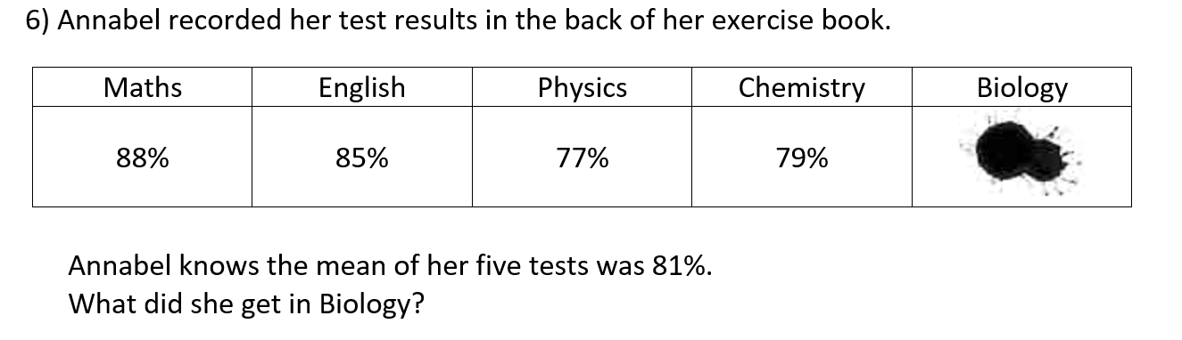
Five tests
81 x 5 = 405
Sum of 4 tests = 88 + 85 + 77 + 79 = 329
Biology test result is 405 – 329 = 76%

Slide 9
7) There are 25 students in a class, 10 girls and 15 boys. On one particular night, the mean time spend on homework by the boys was 1.6 hours and the mean time spent on homework by the girls was 2.1 hours. Work out the mean time spent on homework by all the students in the class. Give your answer in hours and minutes.
Boys
1.6 x 15 = 24 hours
Altogether
24 + 21 = 45 hours
Girls
2.1 x 10 = 21 hours
Mean = 45 ÷ 25 = 1.8 hours
1 hour and 48 mins

