Slide 1
FM: Multiplying Matrices

Slide 2

A matrix (plural: matrices) is
simply an ‘array’ of numbers, e.g.
On a simple level, a matrix is simply a way to organise values into rows and columns.

Slide 3
Matrices is useful as
a way to transform points.
Matrices are useful in 3D graphics,
as matrices can be used to carry out rotations/enlargements.

Slide 4


Dimensions of Matrices
The dimension of a matrix is its size, in terms of
its number of rows and columns.
2 by 3
3 by 1
1 by 3

Slide 5



Notation/Names for Matrices
A matrix can have square or curvy brackets.
Row Vector
Matrix
Column Vector

Slide 6

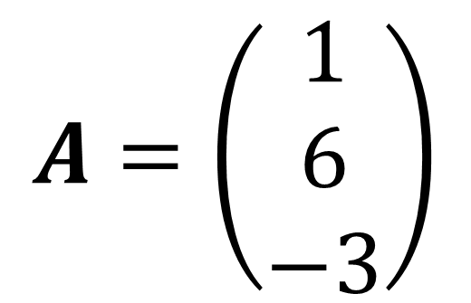
Variables for Matrices
If we wish a variable to represent a matrix, we use bold, capital letters.
$$C=P^{2}TP$$
$$A=\left(\begin{matrix}1 \\ 6 \\ −3\end{matrix}\right)$$

Slide 7
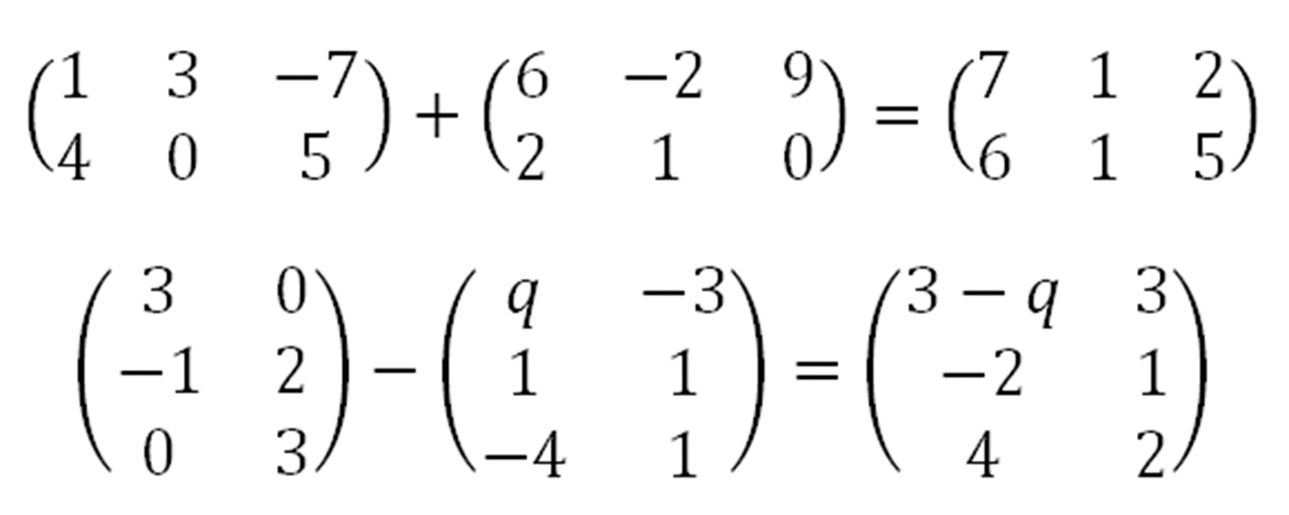
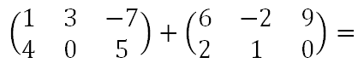
Adding/Subtracting Matrices
Simply add/subtract the corresponding elements of each matrix. They must be of the same dimension.

Slide 8
Adding/Subtracting Matrices

Slide 9
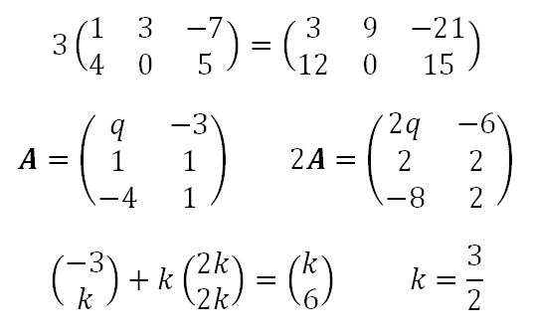
Scalar Multiplication
A scalar is a number which can ‘scale’ the elements inside a matrix/vector.

Slide 10
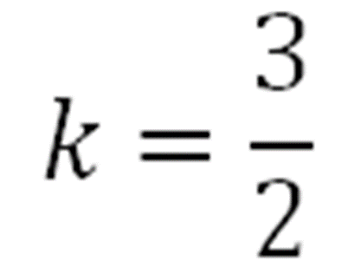
Scalar Multiplication
Find k

Slide 11
Matrix Multiplication
You start with this row and column,
and sum the products of each pair.
(1 x 5) + (0 x 1) + (3 x 0) + (-2 x 8) = -11
1 0 3 -2
2 8 4 3
7 -1 0 2
5 1
1 7
0 3
8 -3
-11
16
42
61
50
-6
Now repeat for the next row of the left matrix...

Slide 12
Matrix Multiplication
1 0 3 -2
2 8 4 3
7 -1 0 2
5 1
1 7
0 3
8 -3
-11
16
42
61
50
-6
(2 x 5) + (8 x 1) + (4 x 0) + (3 x 8) = 42

Slide 13
Matrix Multiplication
1 0 3 -2
2 8 4 3
7 -1 0 2
5 1
1 7
0 3
8 -3
-11
16
42
61
50
-6
(7 x 5) + (-1 x 1) + (0 x 0) + (2 x 8) = 50

Slide 14
Matrix Multiplication
1 0 3 -2
2 8 4 3
7 -1 0 2
5 1
1 7
0 3
8 -3
-11
16
42
61
50
-6
(1 x 1) + (0 x 7) + (3 x 3) + (-2 x -3) = 16
……and so on.

Slide 15

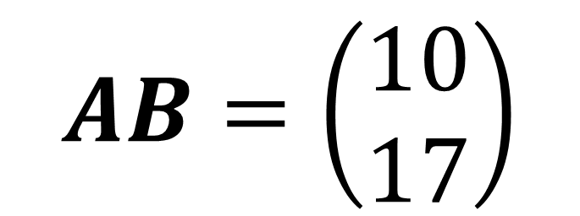
Matrix Multiplication
$$AB=\left(\begin{matrix}10 \\ 17\end{matrix}\right)$$

Slide 16
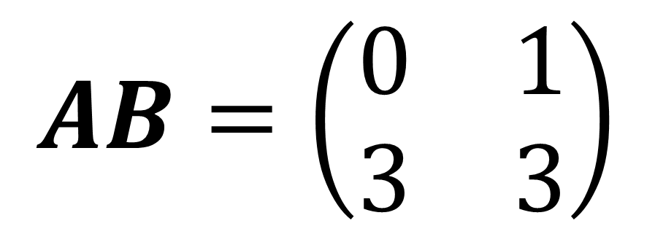
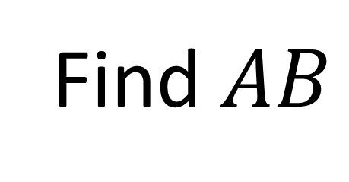
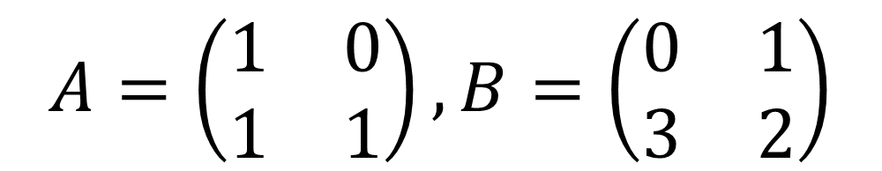
Matrix Multiplication
$$A=\left(\begin{matrix}1 & 0 \\ 1 & 1\end{matrix}\right), B=\left(\begin{matrix}0 & 1 \\ 3 & 2\end{matrix}\right)$$
Find $AB$
$$AB=\left(\begin{matrix}0 & 1 \\ 3 & 3\end{matrix}\right)$$

Slide 17

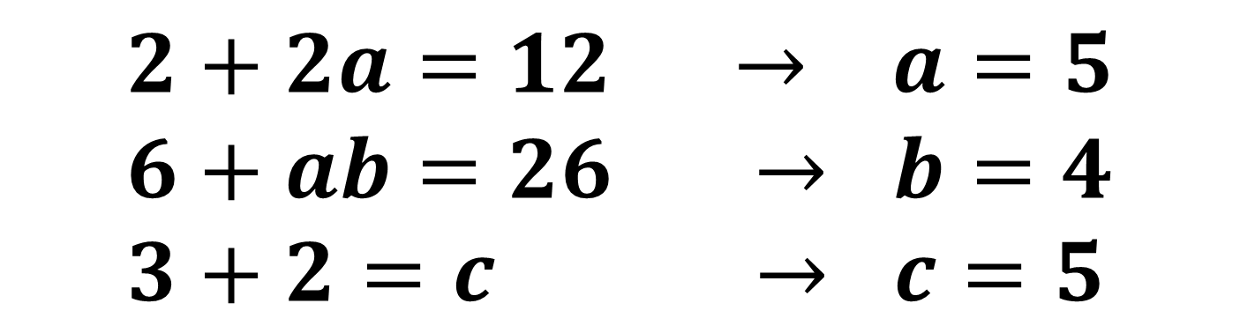
Harder Multiplication Questions
$$2+2a=12 → a=5 \\ 6+ab=26 → b=4 \\ 3+2=c → c=5$$

Slide 18

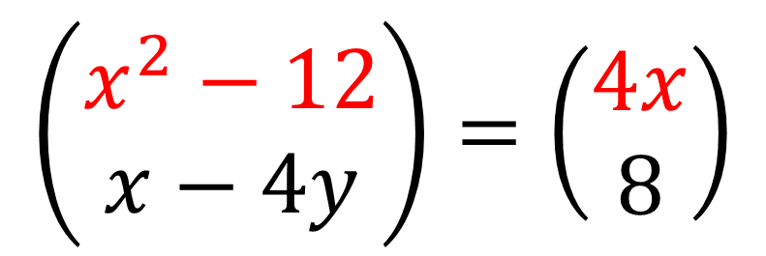
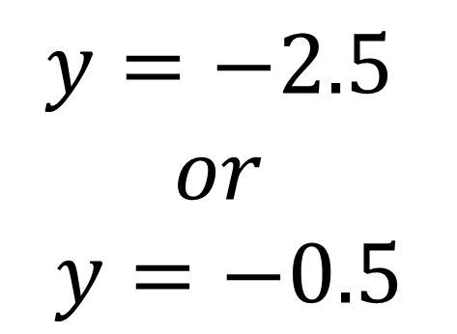
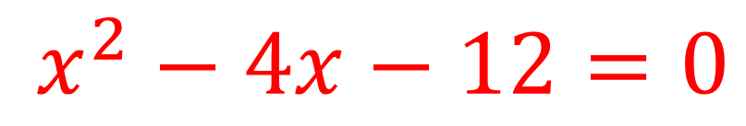
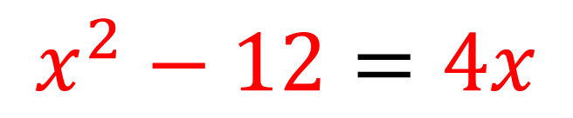
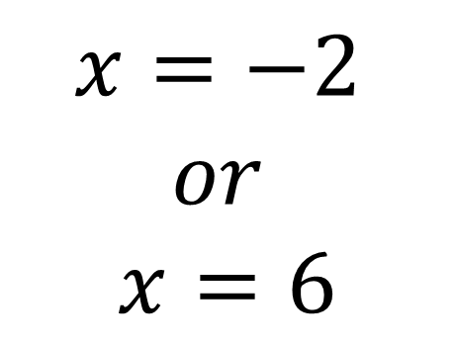
$$\left(\begin{matrix}x^{2}−12 \\ x−4y\end{matrix}\right)=\left(\begin{matrix}4x \\ 8\end{matrix}\right)$$
$$x=−2$$
$$or$$
$$x=6$$
$$y=−2.5$$
$$or$$
$$y=−0.5$$
$$x^{2}−12=4x$$
$$x^{2}−4x−12=0$$

Slide 19
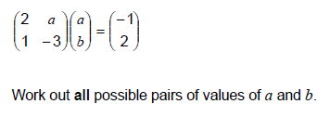

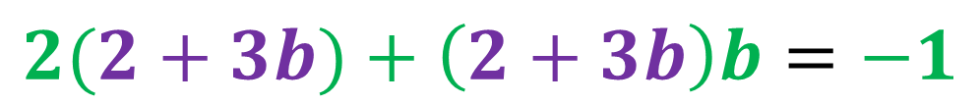


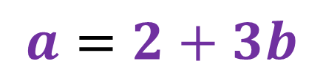
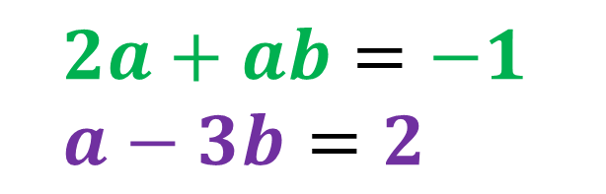
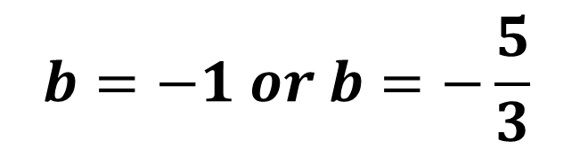
$$2a+ab=−1 \\ a−3b=2$$
$$3b^{2}+8b+5=0$$
$$\left(3b+5\right)\left(b+1\right)=0$$
$$a=2+3b$$
$$b=−1 or b=−\frac{5}{3}$$
$$2(2+3b)+\left(2+3b\right)b=−1$$
$$a=−1 or a=−3$$

