Slide 1
Numerical Solutions
Iteration
Chapter 10
(Part 2 of 3)

Slide 2
Iteration is defined as
the act or process of repeating.
Repetition of a mathematical calculation, as a means of obtaining a closer approximation to the solution.

Slide 3
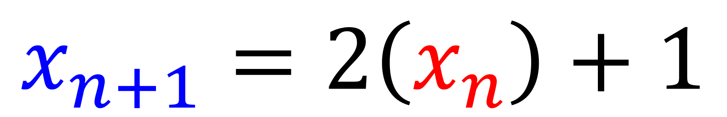
This is an example of an iteration formula
$$x_{n+1}=2\left(x_{n}\right)+1$$
You will always need to be given
a starting value.

Slide 4




$$x_{n+1}=2\left(x_{n}\right)+1$$
An Iteration formula will need to use
the previous answer to calculate the next.
$$x_{2}=2\left(x_{1}\right)+1$$
$$x_{3}=2\left(x_{2}\right)+1$$
$$x_{4}=2\left(x_{3}\right)+1$$

Slide 5
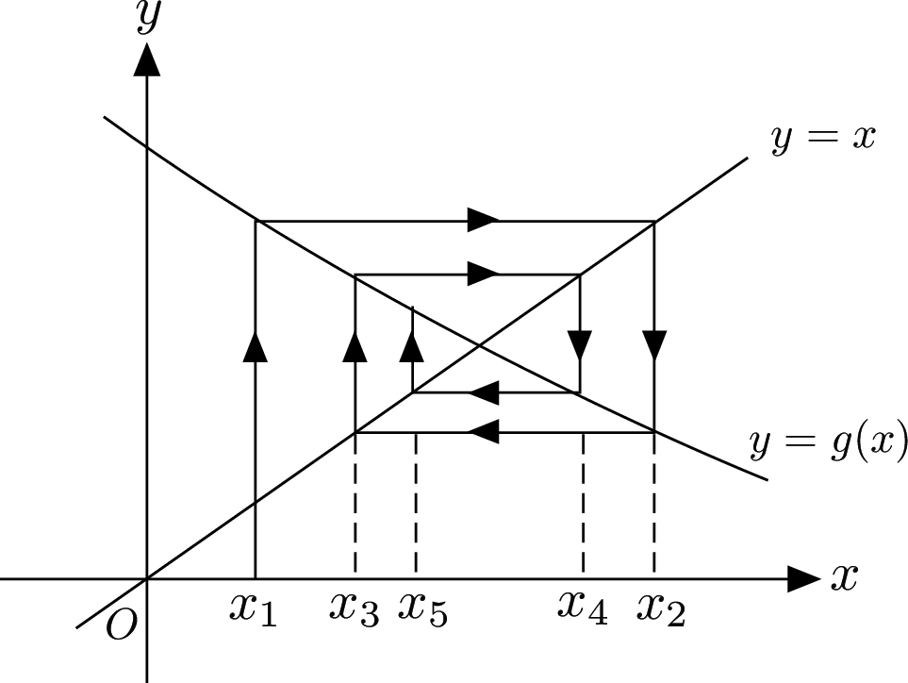
Staircase/Cobweb Graphs
https://www.youtube.com/watch?v=9ebV7sWbgKU

Slide 6
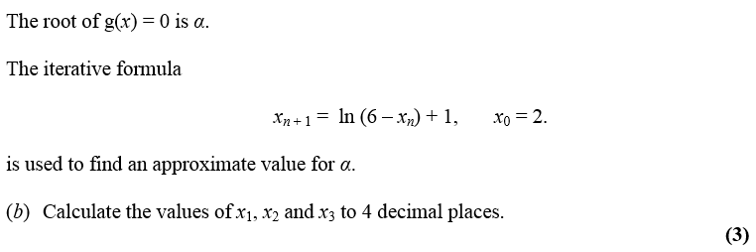
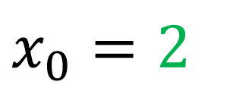


$$x_{0}=2$$
$$x_{1}=\ln\left(6−2\right)+1=2.386…$$
$$x_{2}=2.2847…$$
$$x_{3}=2.3125$$

Slide 7
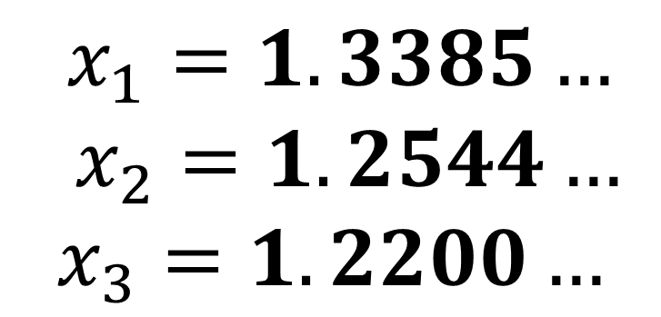
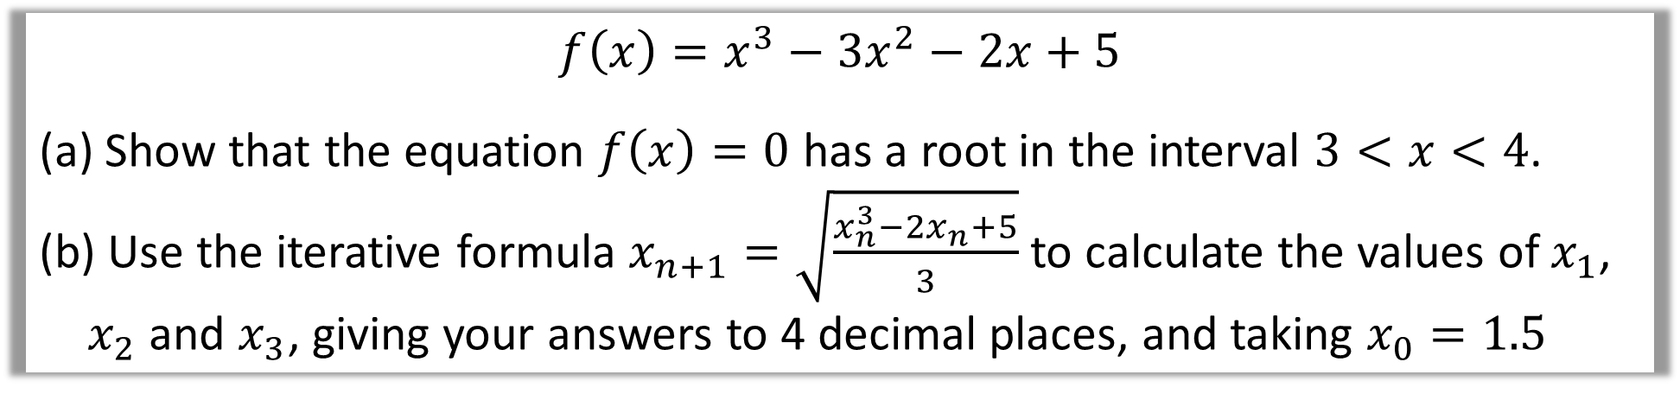
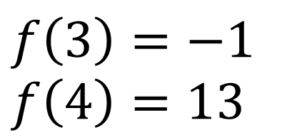
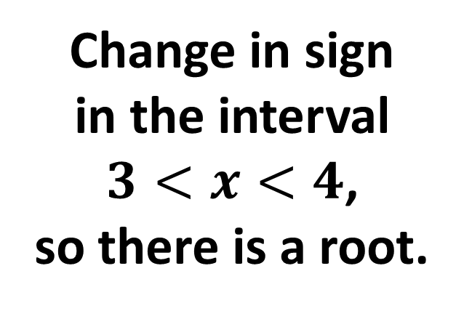
$$f\left(x\right)=x^{3}−3x^{2}−2x+5$$
Show that the equation $f\left(x\right)=0$ has a root in the interval $3<x<4$.
Use the iterative formula $x_{n+1}=\sqrt{\frac{x_{n}^{3}−2x_{n}+5}{3}}$ to calculate the values of $x_{1}$, $x_{2}$ and $x_{3}$, giving your answers to 4 decimal places, and taking $x_{0}=1.5$
a)
$$f\left(3\right)=−1$$
$$f\left(4\right)=13$$
b)
$x_{1}=1.3385…$
$x_{2}=1.2544…$
$$x_{3}=1.2200…$$
Change in sign
in the interval
$3<x<4$,
so there is a root.

Slide 8
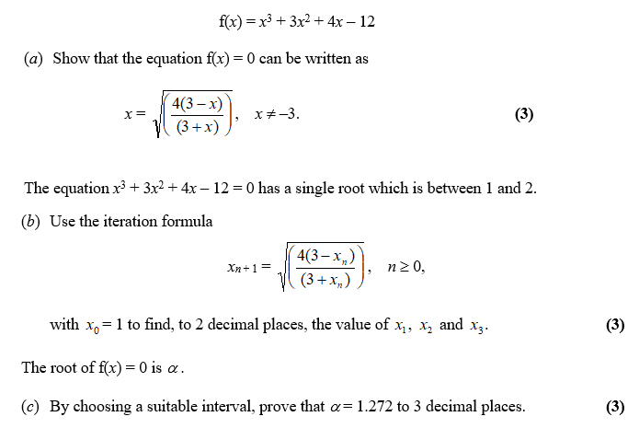

Slide 9
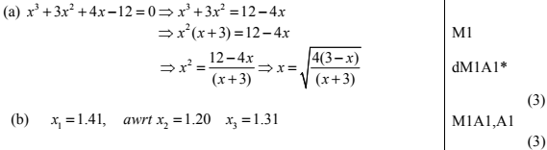
Rearrange the equations to make one of the x values
the subject of the formula.
a)

Slide 10
b)

Slide 11
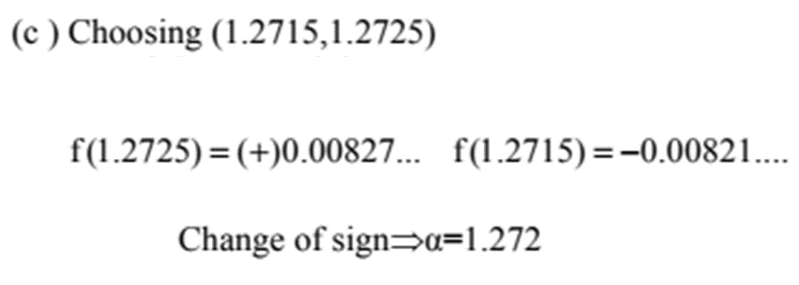
c)

