Slide 1
LO: Simplify Expressions

Slide 2
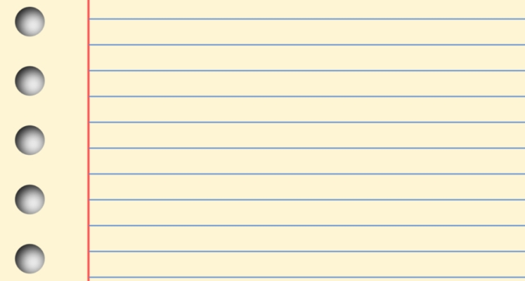

Menu
coke
tea
water
pineapple
apple
salad
burger
c + w + s
What was the order taken?
Coke, Water and Salad.

Slide 3
Menu
coke
tea
water
pineapple
apple
salad
burger
2w + b
What was the order taken?
Two waters and a burger.

Slide 4
2w + b + w + b
What is the quickest way you can write this order?
3w + 2b

Slide 5
2w + b + 5w + 3b + 1
What is the quickest way you can write this order?
7w + 4b + 1

Slide 6
2w + 5 + 3b - b + 1
What is the quickest way you can write this order?
2w + 2b + 6

Slide 7
When you simplify algebra
you need to collect like terms.
4a²
3b
2a²
7a
2b
b²
9a
3b²

Slide 8
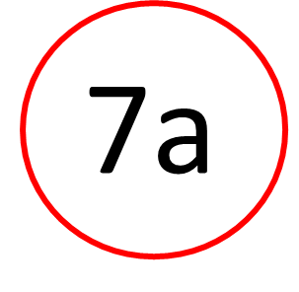
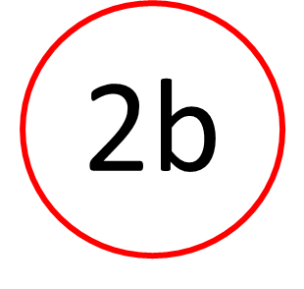
Like terms or Not?
NOT

Slide 9
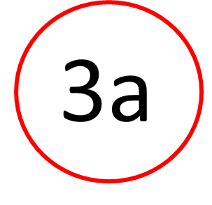
Like terms or Not?
LIKE

Slide 10
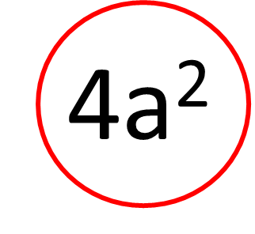

Like terms or Not?
NOT

Slide 11
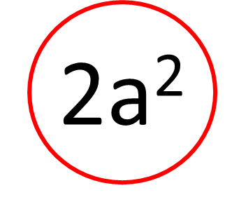
Like terms or Not?
LIKE

Slide 12
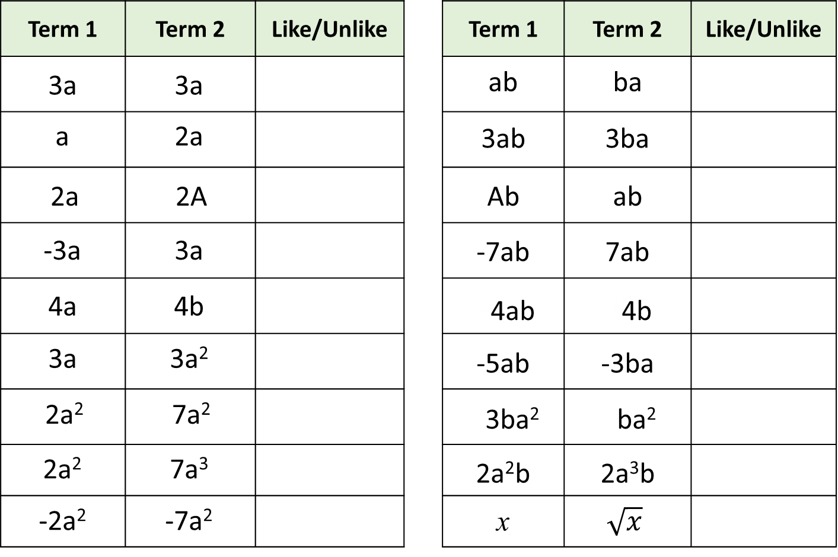
Like
Like
Like
Like
Unlike
Unlike
Like
Like
Unlike
Unlike
Unlike
Like
Like
Like
Unlike
Unlike
Like
Unlike

Slide 13
Simplify the following expression.
3a – 2a + a – 4a =
–2a

Slide 14
Simplify the following expression.
3a – 2 + a – 4 =
4a – 6

Slide 15
Simplify the following expression.
4a² + 5a² – 2a² =
7a²

Slide 16
Simplify the following expression.
4a² + 5a – 2a² – 2a =
2a² + 3a

Slide 17
Which expression has been simplified correctly?
A)
4a² + 2a = | 6a³
B)
4a² + 2a = | 6a²
Neither!
4a² + 2a = | 4a² + 2a

