Slide 1
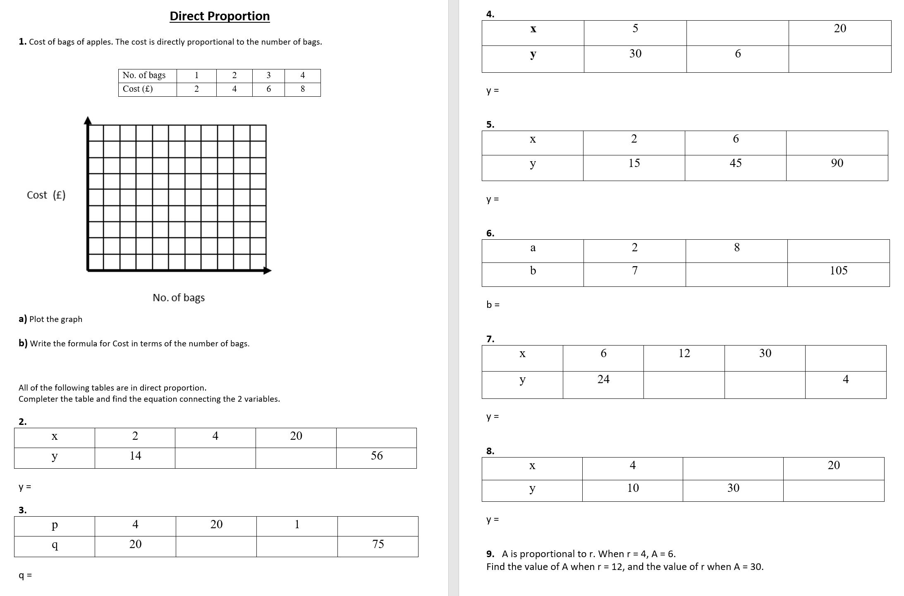

Slide 2
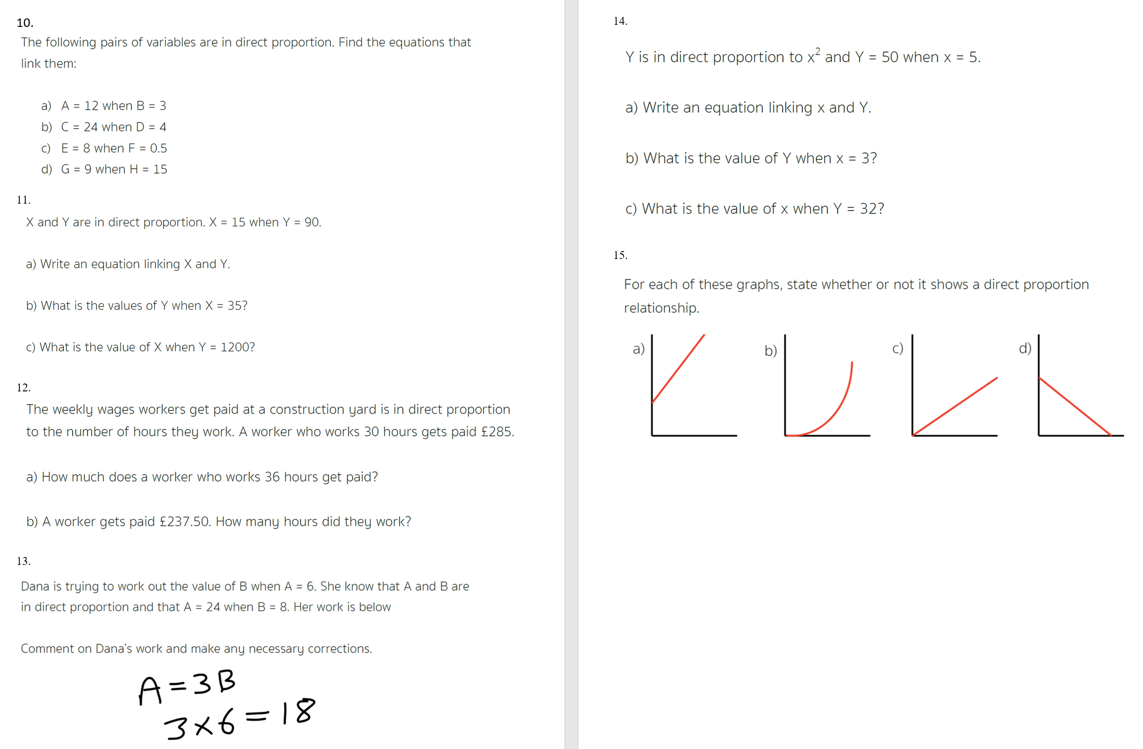

Slide 3
ANSWERS

Slide 4
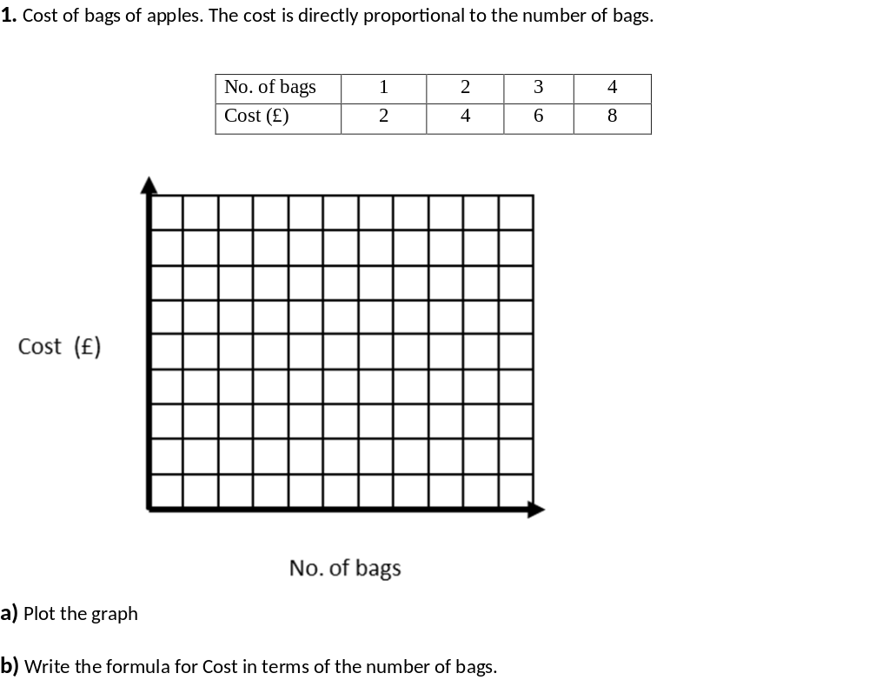
Cost = 2 x bags

Slide 5
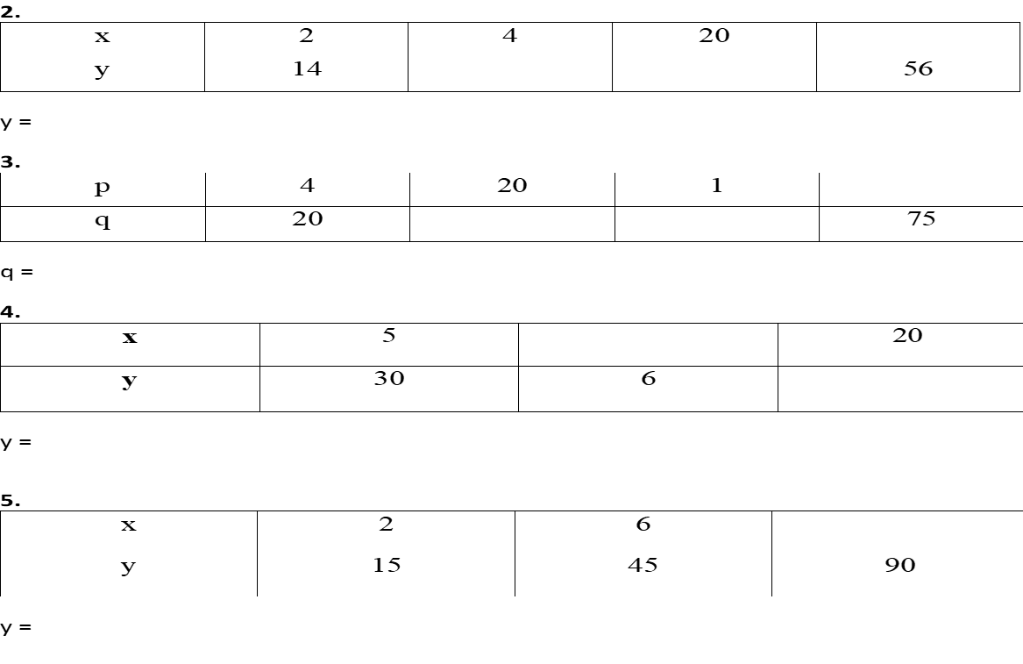
8
28
140
7x
15
100
5
5p
1
120
6x
12
7.5x

Slide 6
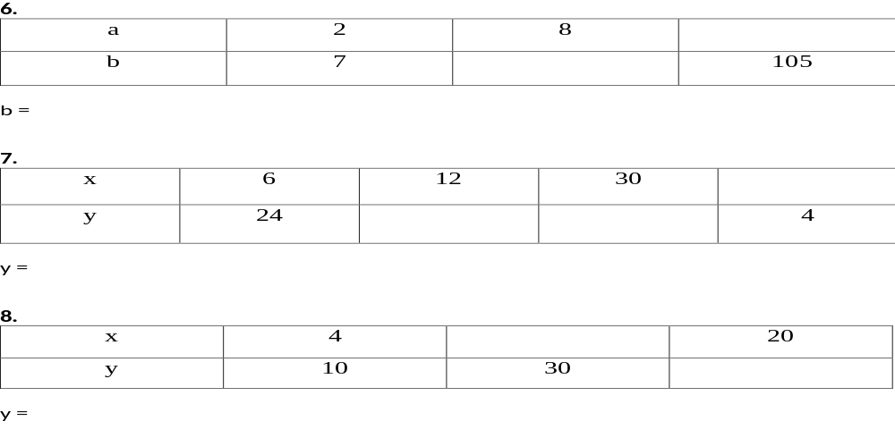
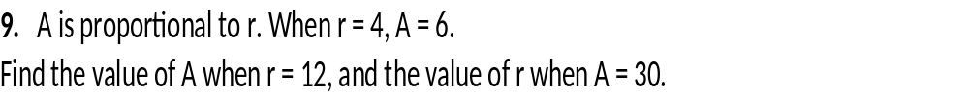
30
28
3.5a
1
48
120
4x
12
50
A = 1.5r
A = 18
r = 20

Slide 7
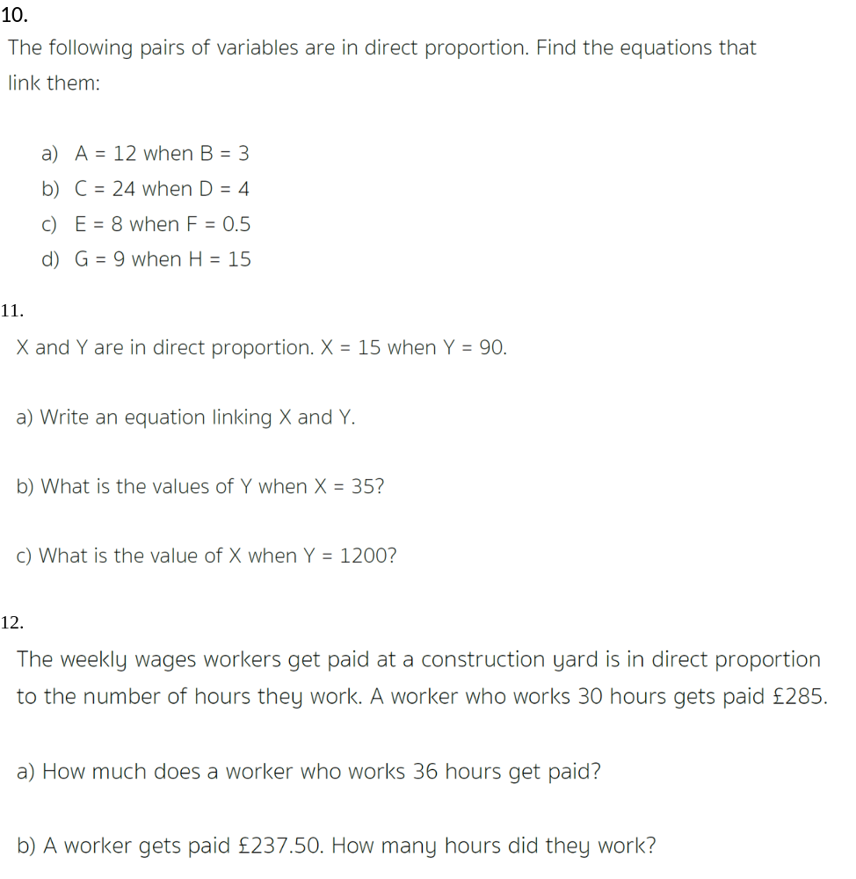

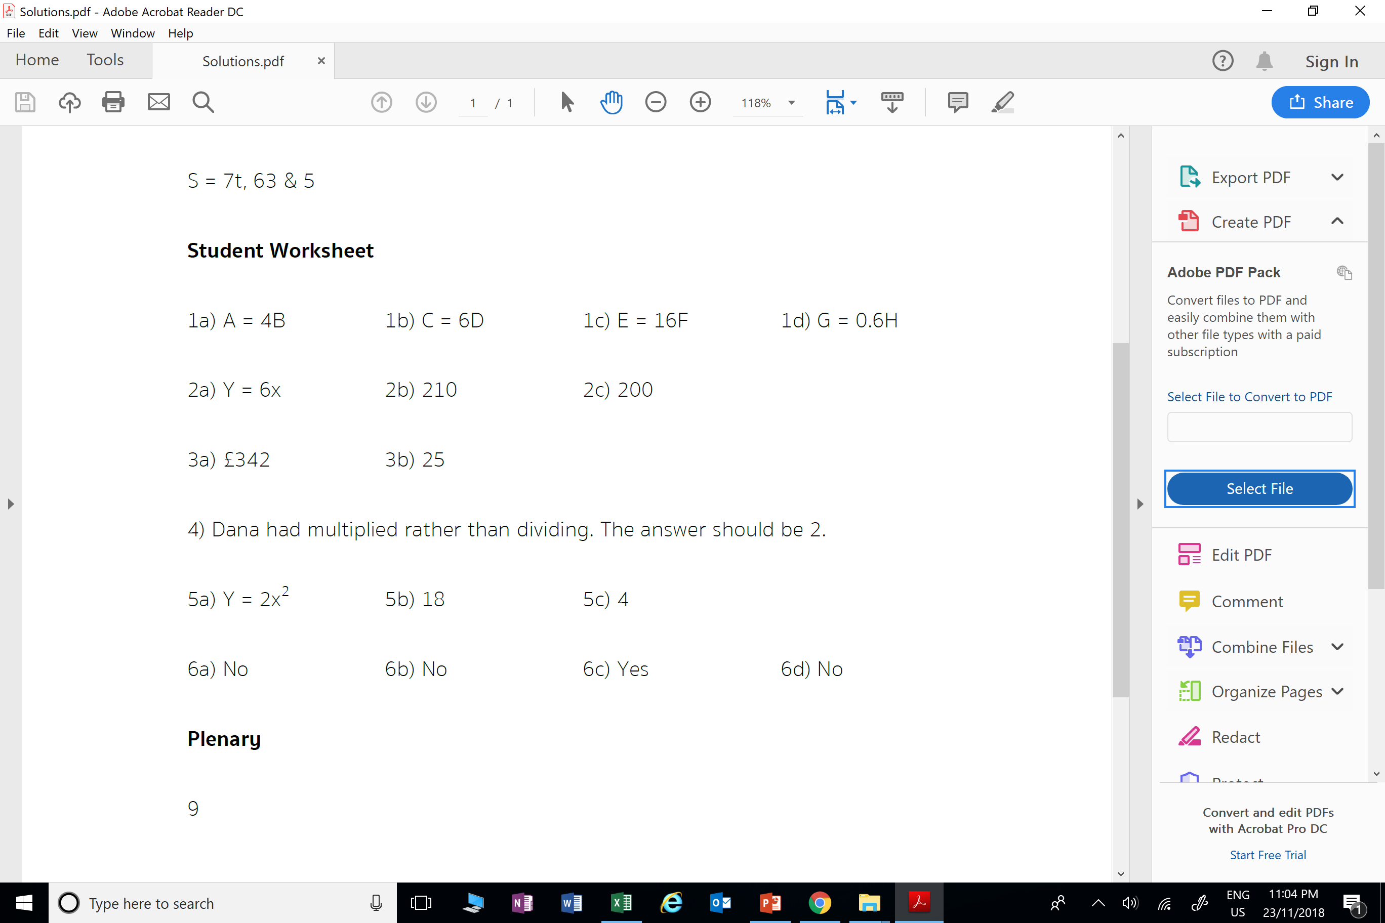

Slide 8
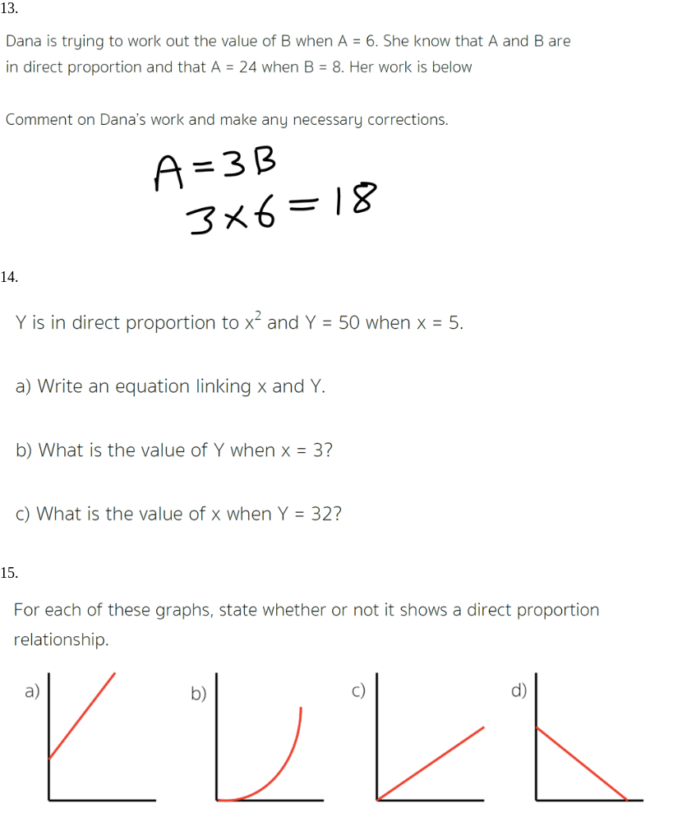

a) y = 2x²
b) 18
c) 4

