Slide 1
LO: Tessellations

Slide 2
A tessellation is a repeating pattern.
No gaps and No overlapping

Slide 3
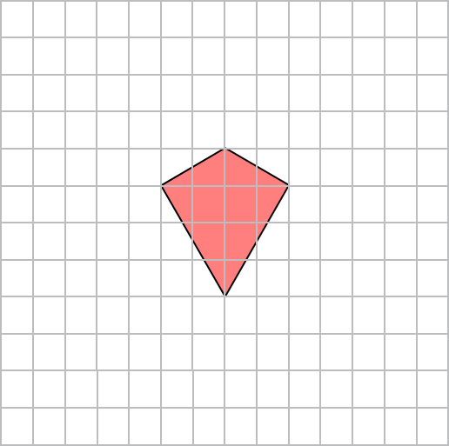
Will the following shapes tessellate?
Drag on the shapes to find out.

Slide 4
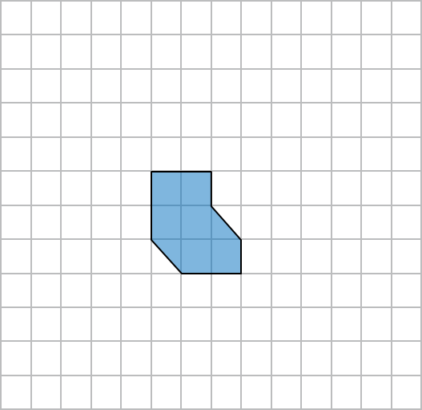

Will the following shapes tessellate?
Drag on the shapes to find out.

Slide 5
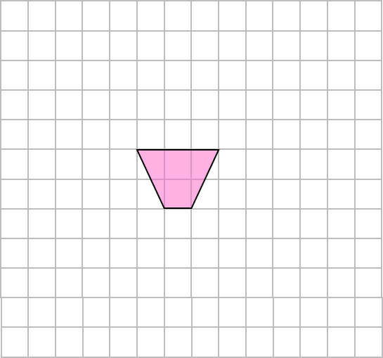
Will the following shapes tessellate?
Drag on the shapes to find out.

Slide 6
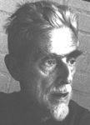
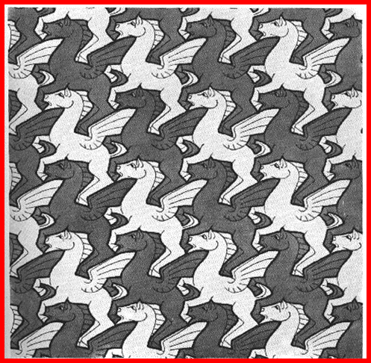
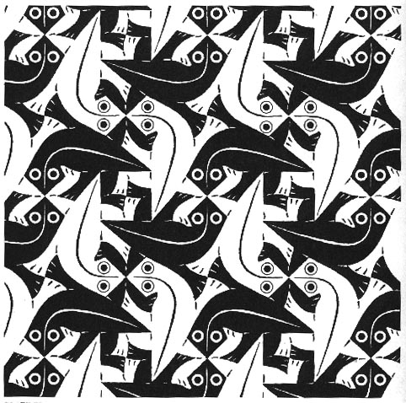
Escher
1898-1972
Escher was a Dutch artist.
Escher often created work that involved tessellations.

Slide 7
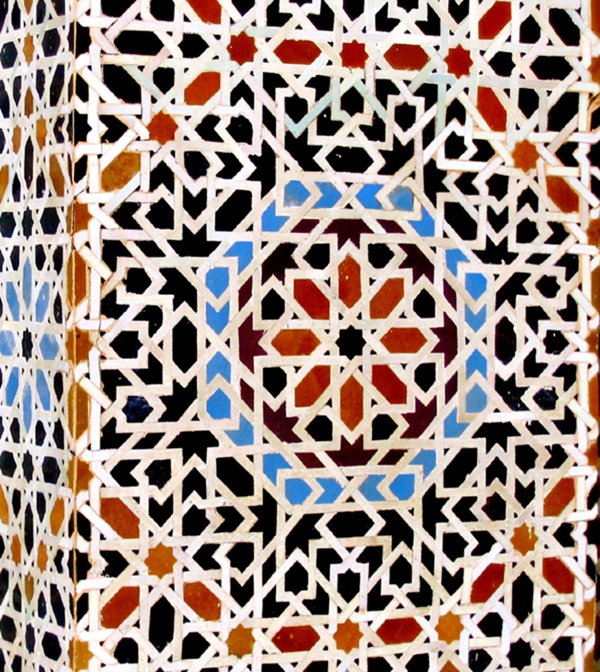
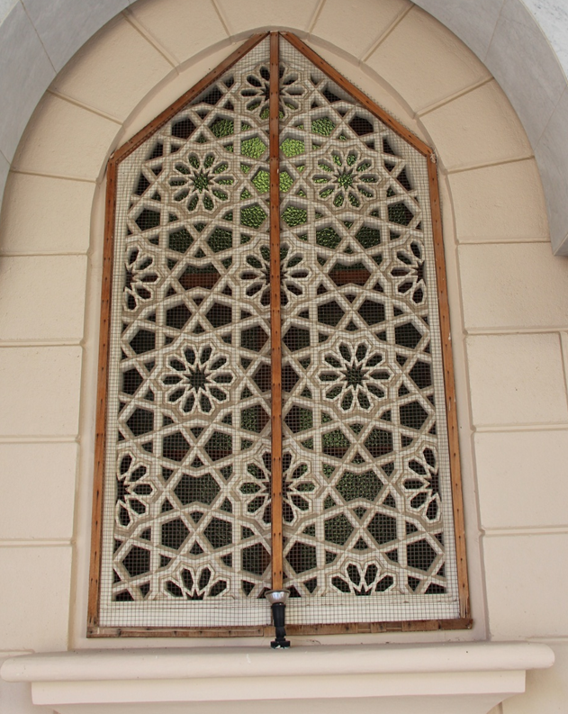
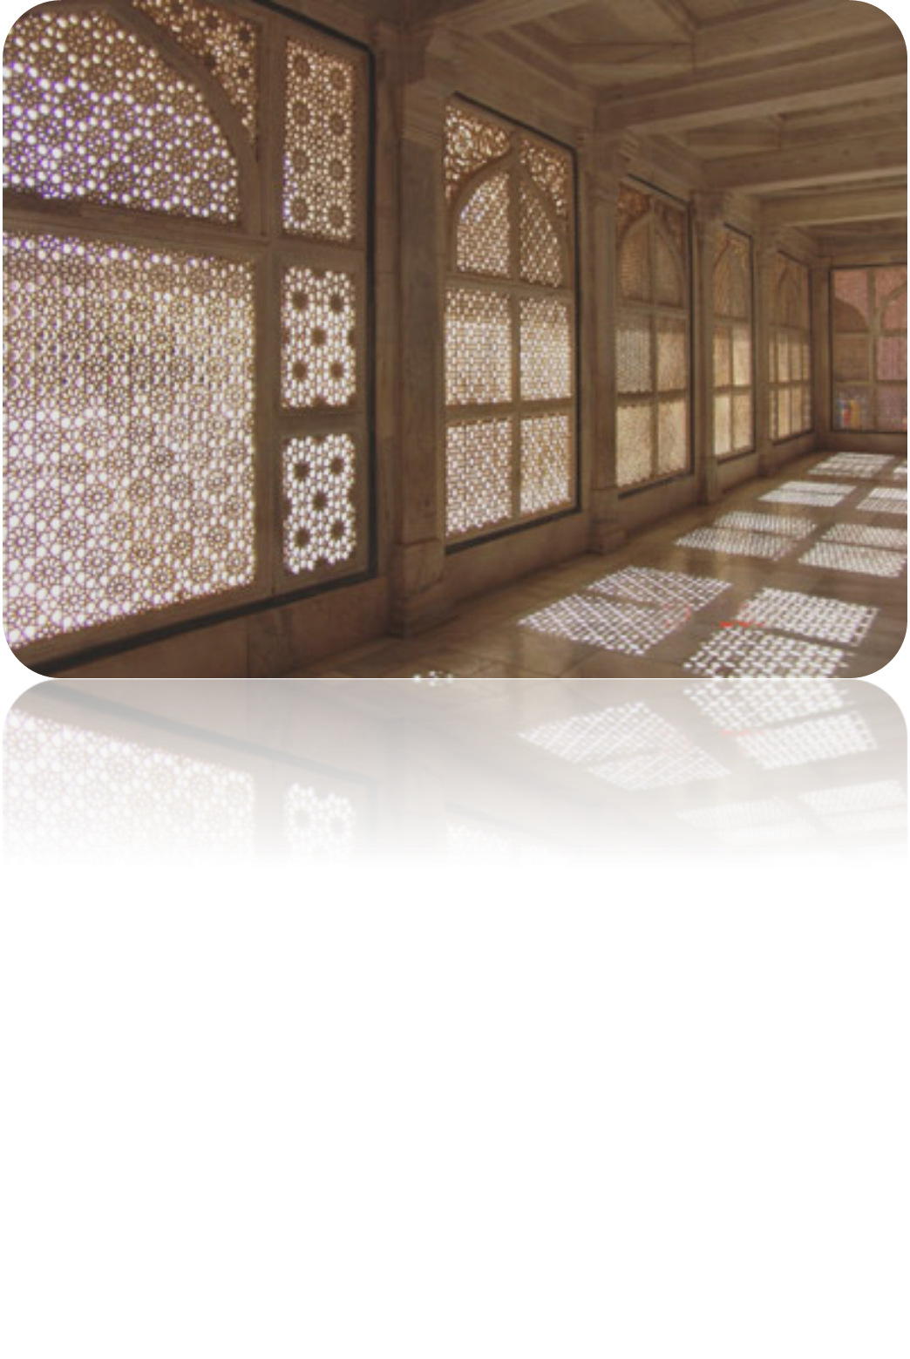
It is very common for Islamic art to use tessellating patterns.
Tessellating patterns can be found in architecture on walls, floors and ceilings, in textiles, jewellery, book covers, pots and furniture.

