Slide 1
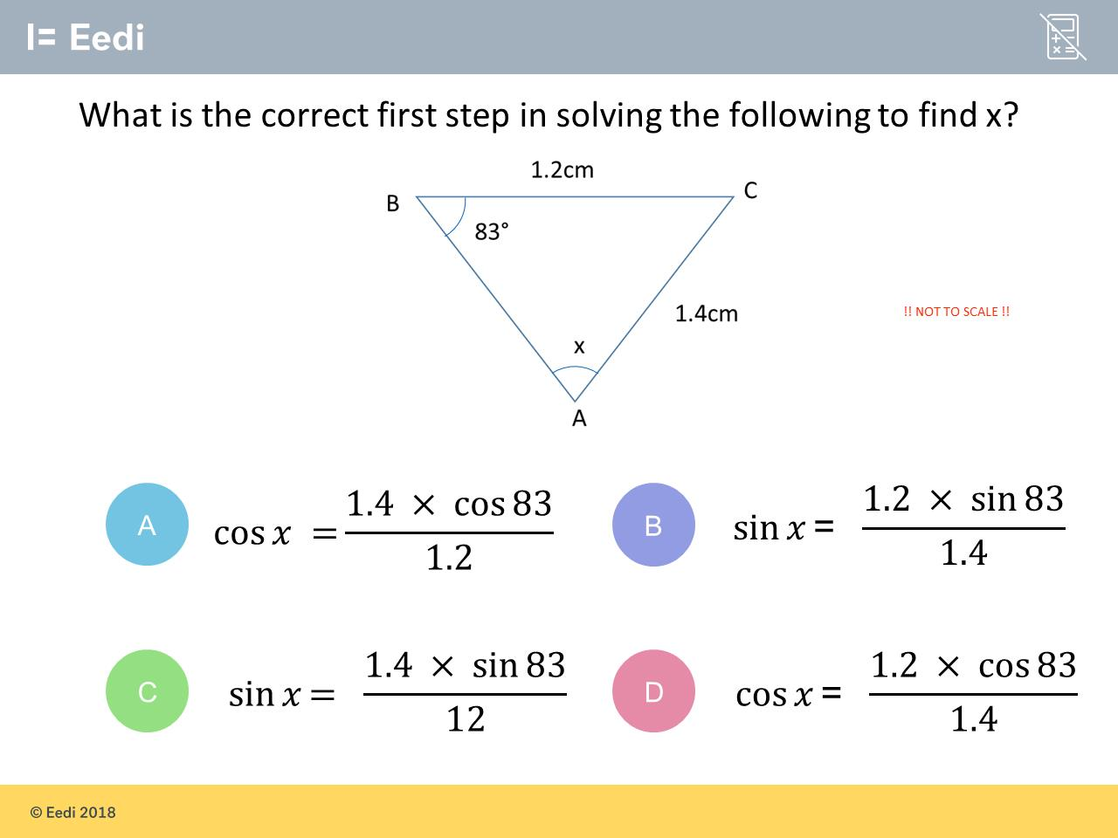
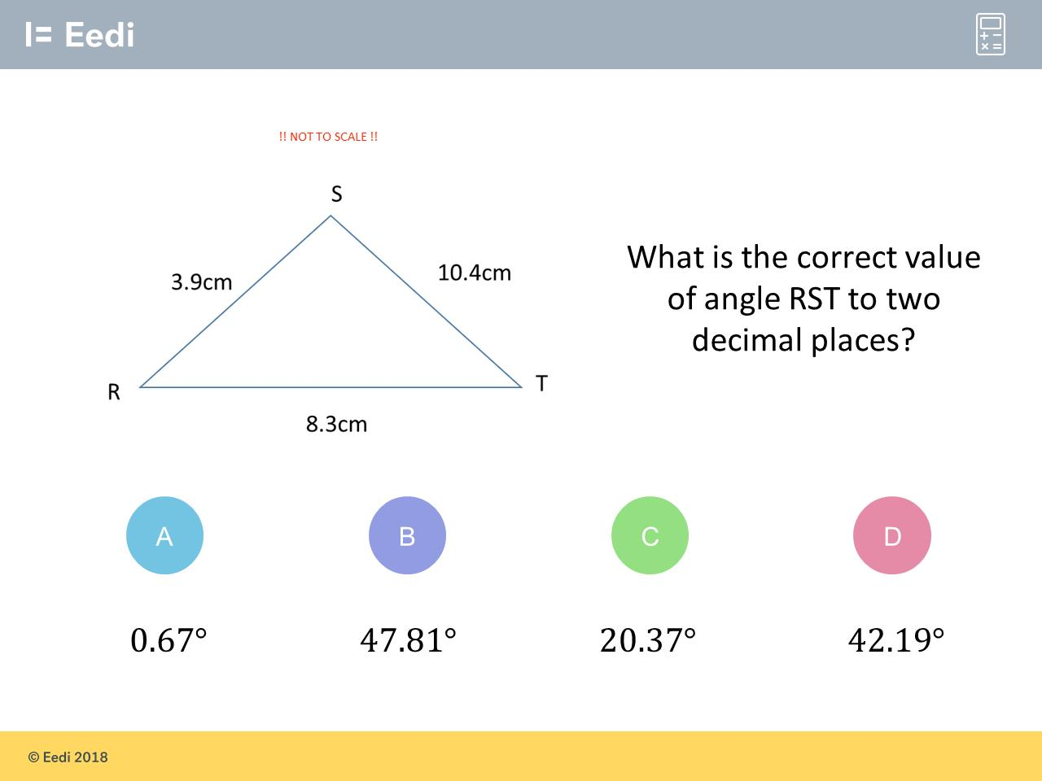
Worst answered question?
Most common wrong answer?

Slide 2
ANSWERS

Slide 3
Worst answered question?

Slide 4
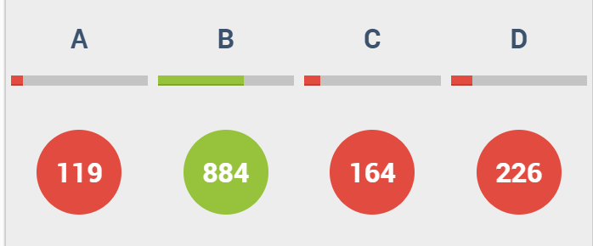
D
The student has used sin, rather than cosine,
in the formula.

Slide 5
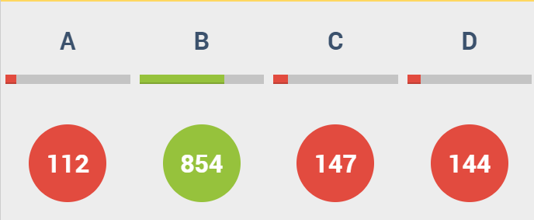
C
The student has mixed up
the lengths
1.2 and 1.4.

