Slide 1
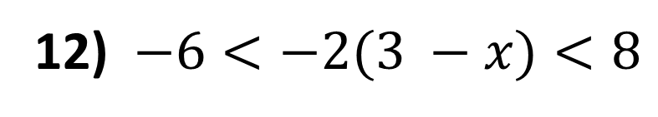
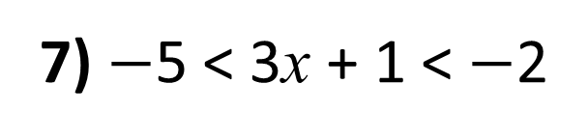
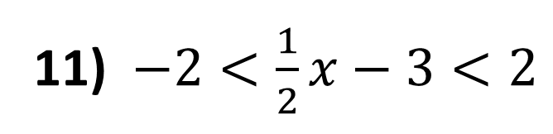
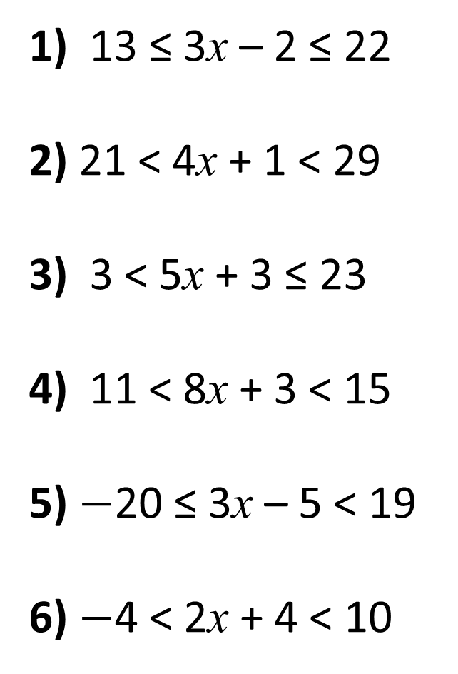
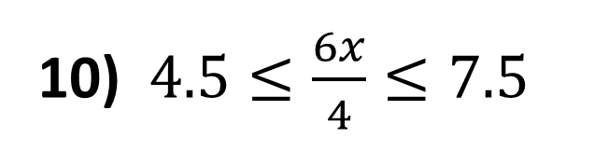
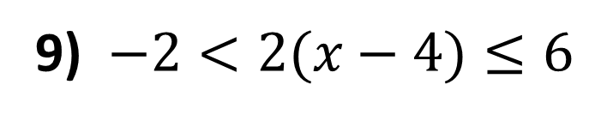
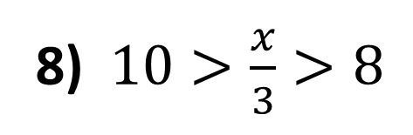
Solving Double Inequalities
1) 13 ≤ 3x – 2 ≤ 22
2) 21 < 4x + 1 < 29
3) 3 < 5x + 3 ≤ 23
4) 11 < 8x + 3 < 15
5) $−$20 ≤ 3x – 5 < 19
6) $−$4 < 2x + 4 < 10
7) $−$5 < 3x + 1 < $−$2
8) $10>\frac{x}{3}>8$
9) $−2<2(x−4)≤6$
10) $4.5≤\frac{6x}{4}≤7.5$
11) $−2<\frac{1}{2}x−3<2$
12) $−6<−2(3 −x)<8$

Slide 2
ANSWERS

Slide 3
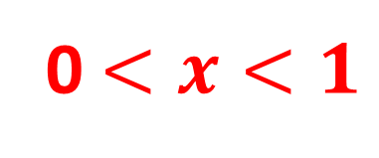
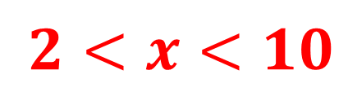
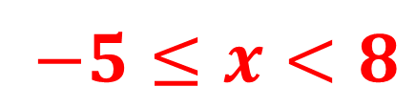
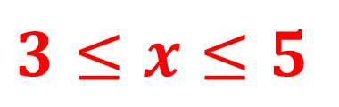
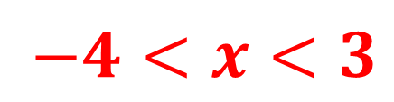
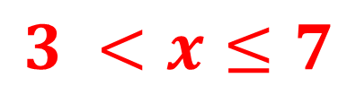
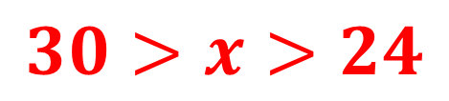
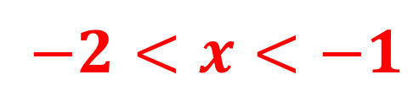
Solving Double Inequalities
1) 13 ≤ 3x – 2 ≤ 22
2) 21 < 4x + 1 < 29
3) 3 < 5x + 3 ≤ 23
4) 11 < 8x + 3 < 15
5) $−$20 ≤ 3x – 5 < 19
6) $−$4 < 2x + 4 < 10
7) $−$5 < 3x + 1 < $−$2
5 ≤ x ≤ 8
$−2<x<−1$
8) $10>\frac{x}{3}>8$
$$30>x>24$$
5 < x < 7
9) $−2<2(x−4)≤6$
0 < x ≤ 4
$$3 <x≤7$$
10) $4.5≤\frac{6x}{4}≤7.5$
1 < x < 1.5
$$3≤x≤5$$
11) $−2<\frac{1}{2}x−3<2$
$−5≤x<8$
$2<x<10$
12) $−6<−2(3 −x)<8$
$−4<x<3$
0 $<x<1$

