Slide 1
LO: Product of
Prime Factors

Slide 2
Product
Prime
Factors

Slide 3
What does the word
‘PRODUCT’ mean in mathematics?
Multiply

Slide 4
What is the definition of a PRIME NUMBER?
A number that only has
two factors.

Slide 5
What is the definition of a FACTORS?
A number that when multiplied with another produces a given number.

Slide 6
Why is 1 not a prime number?
1
It only has one factor.

Slide 7
Can you list all the
prime numbers under 20?
2
3
5
7
11
13
17
19

Slide 8
What are the factors of 20?
1
2
4
5
10
20
What are the prime factors of 20?
2
5

Slide 9
What are the factors of 18?
1
2
3
6
9
18
What are the prime factors of 18?
2
3

Slide 10
What are the prime factors
of 35?
7
5

Slide 11
What are the prime factors
of 28?
2
7

Slide 12
Factor
Trees
20
20
10
4
2
5
2
5
2
2

Slide 13
30
Product of Prime Numbers
10
3
2 x 3 x 5 = 30
2
5

Slide 14
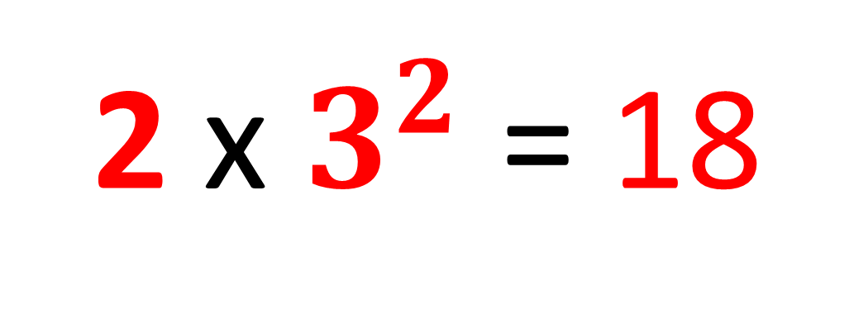
18
Product of Prime Numbers
in Index From
2 x 3 x 3 = 18
9
2
below it is in index form
2 x $3^{2}$ = 18
3
3

Slide 15
Express 360 as a product of its prime factors
360
2
180
2
90
2
45
5
9
3
3
360 = 2 x 2 x 2 x 5 x 3 x 3

