Slide 1
LO: Pyramid (Surface Area)

Slide 2
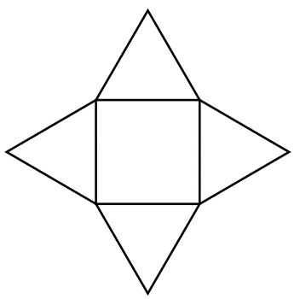
Can you draw a net of a square base pyramid?

Slide 3
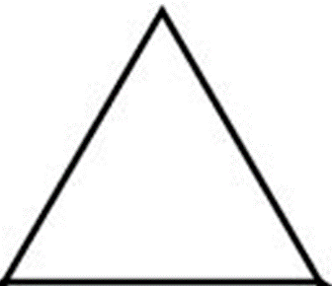
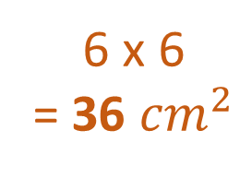
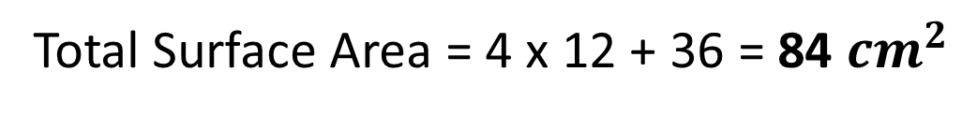
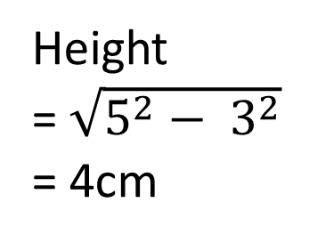
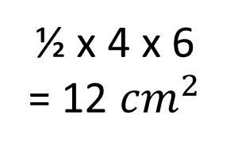
Find the total surface of the square base pyramid?
½ x 4 x 6
= 12 ${cm}^{2}$
5cm
6 x 6
= 36 ${cm}^{2}$
6cm
6cm
Height
= $\sqrt{5^{2}− 3^{2}}$
= 4cm
5cm
Height
6cm
Total Surface Area = 4 x 12 + 36 = 84 ${cm}^{2}$

Slide 4
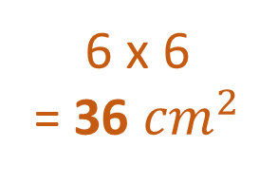
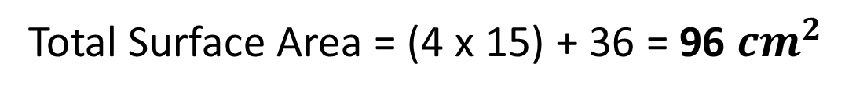
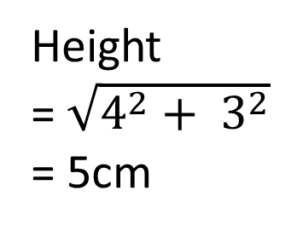
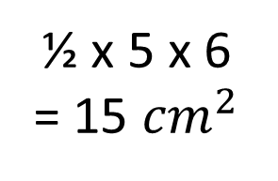
Find the total surface of the square base pyramid?
½ x 5 x 6
= 15 ${cm}^{2}$
4cm
6 x 6
= 36 ${cm}^{2}$
6cm
6cm
Height
= $\sqrt{4^{2}+ 3^{2}}$
= 5cm
4cm
3cm
Total Surface Area = (4 x 15) + 36 = 96 ${cm}^{2}$

Slide 5
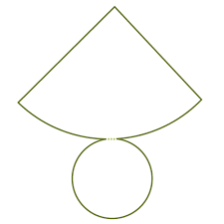
Can you draw a net of cone?

Slide 6

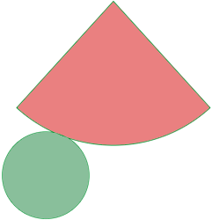

Surface Area of a Cone
Curved Surface Area = $πrl$
l
h
r

Slide 7
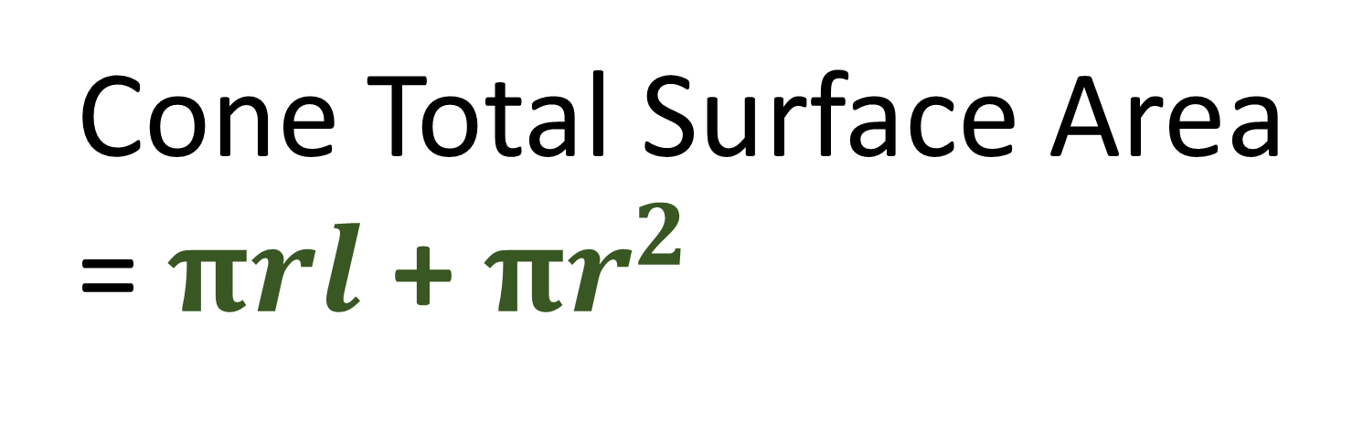
Can you write a formula
for total surface area?
Cone Total Surface Area
= $πrl$ + $πr^{2}$
l
h
r

Slide 8
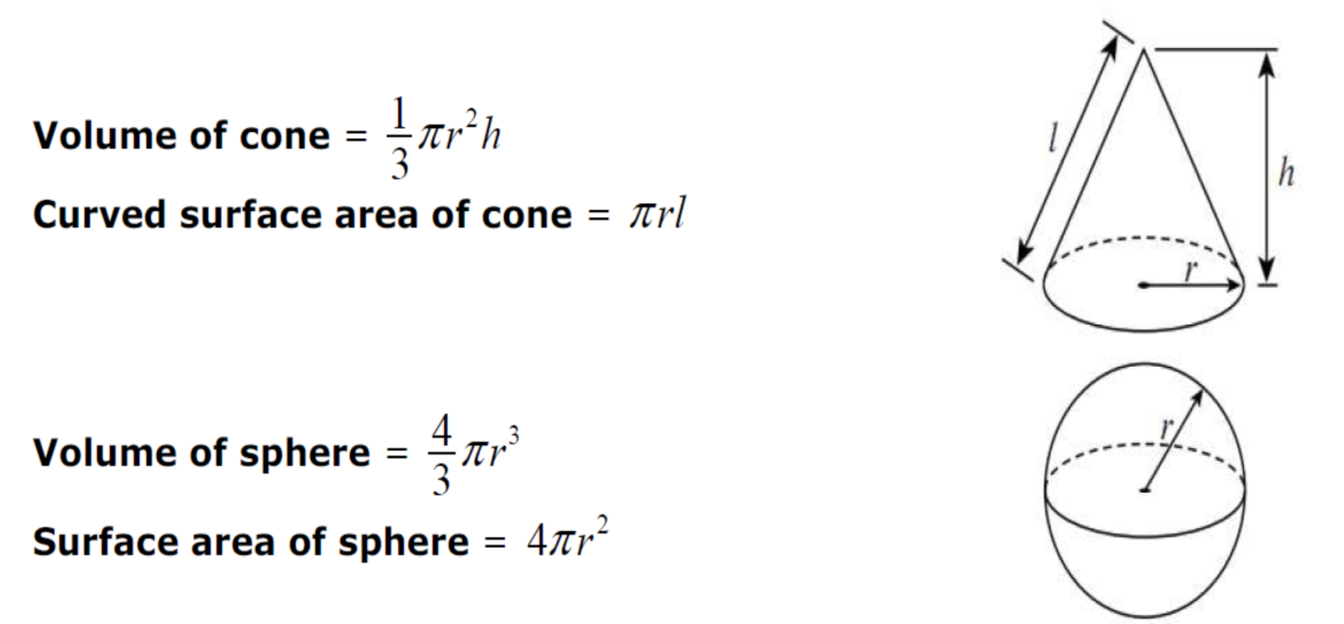
FORMULA SHEET

Slide 9


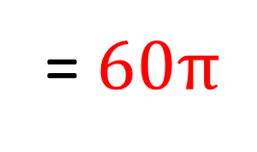

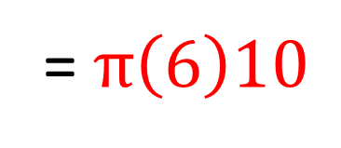
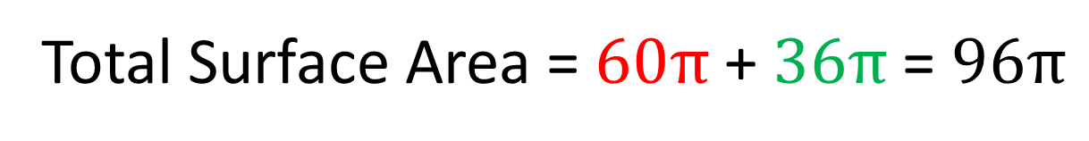
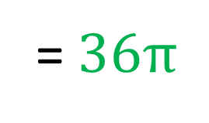
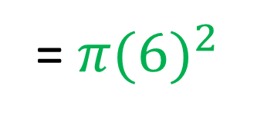
What is the surface area of the cone?
Give your answer in terms of $π$
Curved Surface Area = $πrl$
= $π\left(6\right)10$
10
= $60π$
8
Surface Area Circle = $πr^{2}$
= $π{(6)}^{2}$
6
= $36π$
Total Surface Area = $60π$ + $36π$ = $96π$

