Slide 1
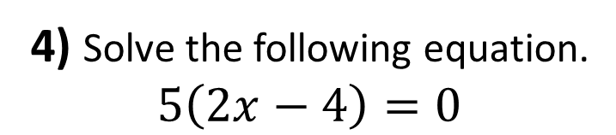

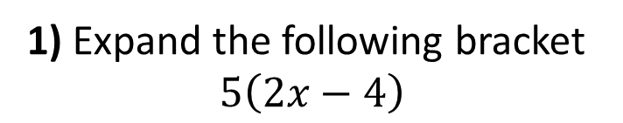

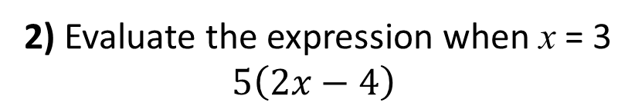
1) Expand the following bracket
$$5\left(2x−4\right)$$
2) Evaluate the expression when x = 3
$5\left(2x−4\right)$
3) Write an expression for the area of the rectangle.
4) Solve the following equation.
$5\left(2x−4\right)=0$
$$2x−4$$
$$5$$

Slide 2
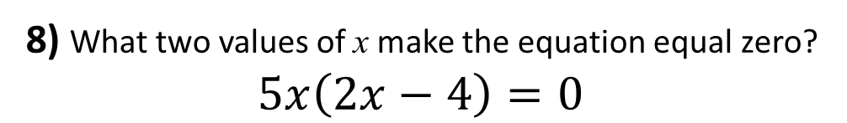
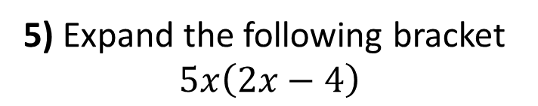

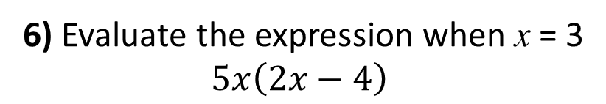
5) Expand the following bracket
$$5x\left(2x−4\right)$$
6) Evaluate the expression when x = 3
$5x\left(2x−4\right)$
7) Write an expression for the area of the rectangle.
8) What two values of x make the equation equal zero?
$5x\left(2x−4\right)=0$
$$2x−4$$
$$5x$$

Slide 3
ANSWERS

Slide 4
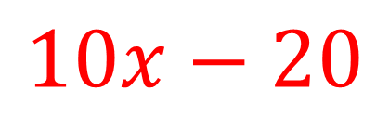
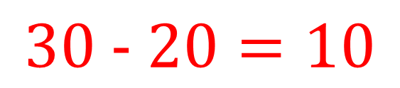
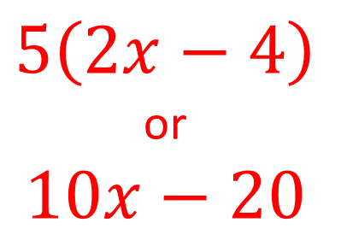
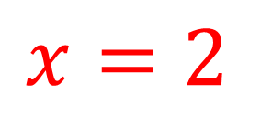
1) Expand the following bracket
$$5\left(2x−4\right)$$
2) Evaluate the expression when x = 3
$5\left(2x−4\right)$
$$10x−20$$
$30\text{ −} 20=10$
3) Write an expression for the area of the rectangle.
4) Solve the following equation.
$5\left(2x−4\right)=0$
$$2x−4$$
$$5\left(2x−4\right)$$
or
$$10x−20$$
$$x=2$$
$$5$$

Slide 5
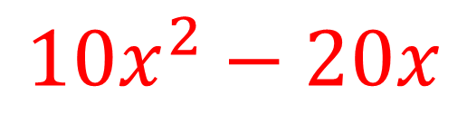
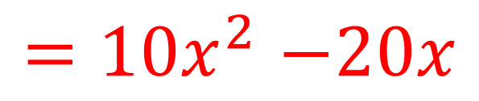
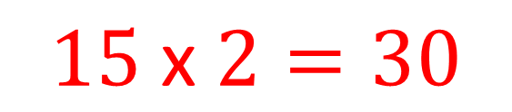
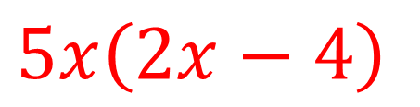
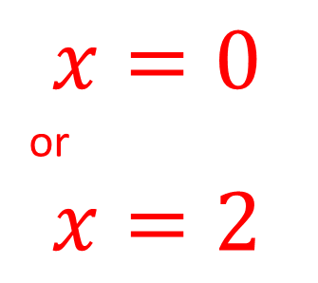
5) Expand the following bracket
$$5x\left(2x−4\right)$$
6) Evaluate the expression when x = 3
$5x\left(2x−4\right)$
$${10x}^{2}−20x$$
$15 \text{x} 2=30$
7) Write an expression for the area of the rectangle.
8) What two values of x make the equation equal zero?
$5x\left(2x−4\right)=0$
$$2x−4$$
$$x=0$$
or
$$x=2$$
$$5x$$
$5x\left(2x−4\right)$
$${=10x}^{2}−20x$$

