Slide 1
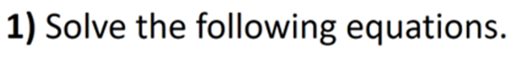
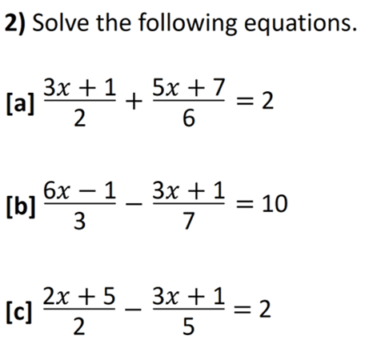
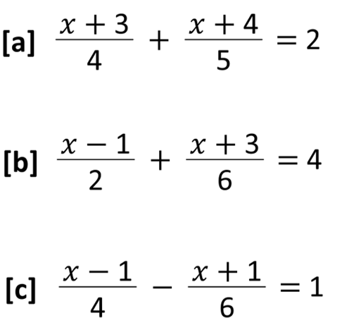

Slide 2
ANSWERS

Slide 3


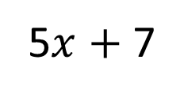
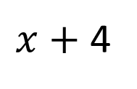

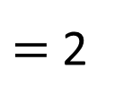
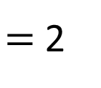
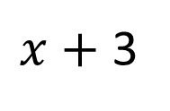
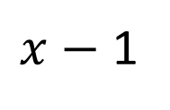
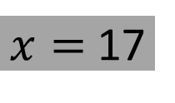

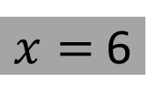



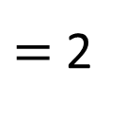
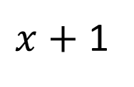
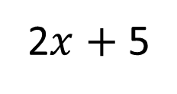
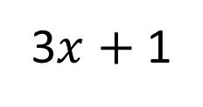

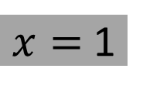

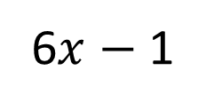
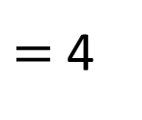

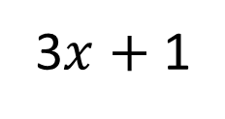
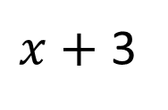

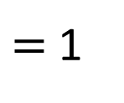

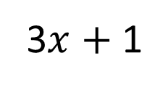
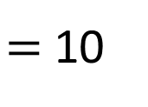
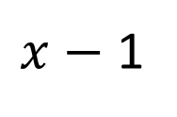
1) Solve the following equations.
2) Solve the following equations.
$x$ $+$ 3
$x$ $+$ 4
[a]
$+$
$=$ 2
$x=$ 1
3$x$ $+$ 1
5$x$ $+$ 7
1
4
5
[a]
$+$
$=$ 2
$$x$$
$$=$$
2
6
7
20
$x$ $−$ 1
$x$ $+$ 3
6$x$ $−$ 1
3$x$ $+$ 1
[b]
$+$
$=$ 4
$x=$ 6
[b]
$−$
$=$ 10
$$x$$
$$=$$
2
6
3
7
3
$x$ $−$ 1
$x$ $+$ 1
2$x$ $+$ 5
3$x$ $+$ 1
3
[c]
$−$
$=$ 1
$x=$ 17
[c]
$−$
$=$ 2
$$x$$
$$=−$$
4
6
2
5
4

