Slide 1
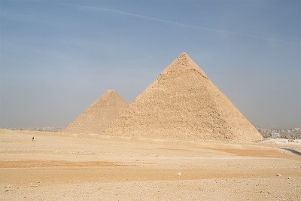
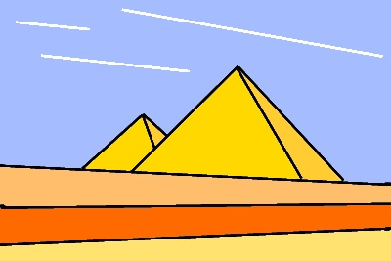
Painting Between the Lines
Pictures can be represented in an abstract way using straight lines.

Slide 2
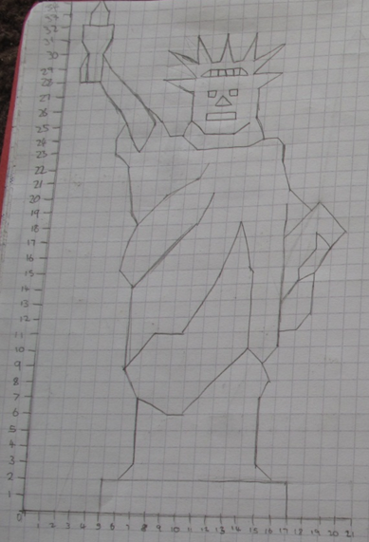
In abstract or computer generated art,
a real object is often represented by a simplified set of shapes, lines or curves.

Slide 3
If you wanted to describe mathematically the line segments used to draw this picture, all you would need to do is decide where to put the axes and then work out the equations of all the straight lines.
Draw axes for x between 0 and 14 and y between 0 and 17.
1) y = 32 - 2x between x = 8 and x = 12
2) y = 8 between x = 4 and x = 12
3) x = 7.5 between y = 7 and y = 8
4) y = 2x - 15 between x = 10 and x = 11
5) y = 7 between x = 4 and x = 11
6) y = 2x between x = 4 and x = 8
7) y = 5 between x = 5 and x = 10
8) y = 15 - 2x between x = 4 and x = 5

Slide 4
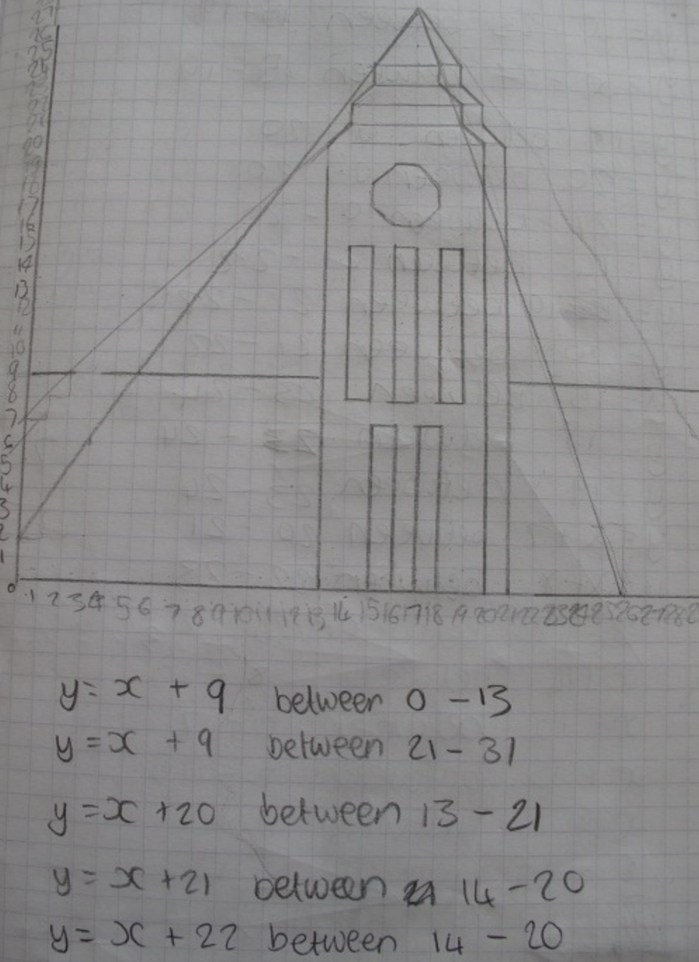
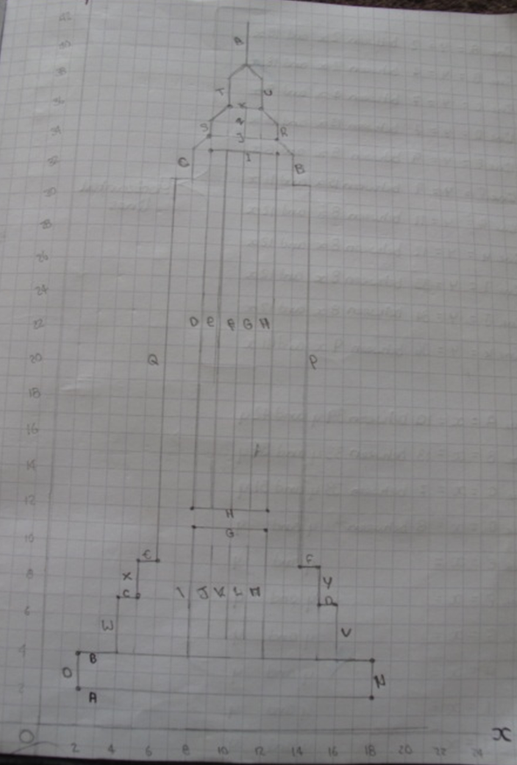

Slide 5
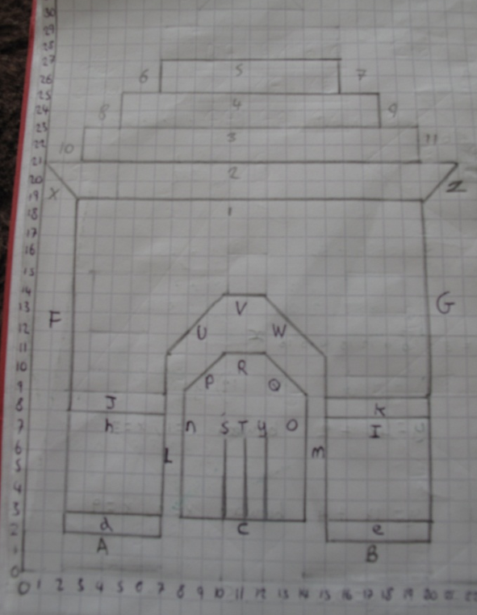

Slide 6
