Slide 1
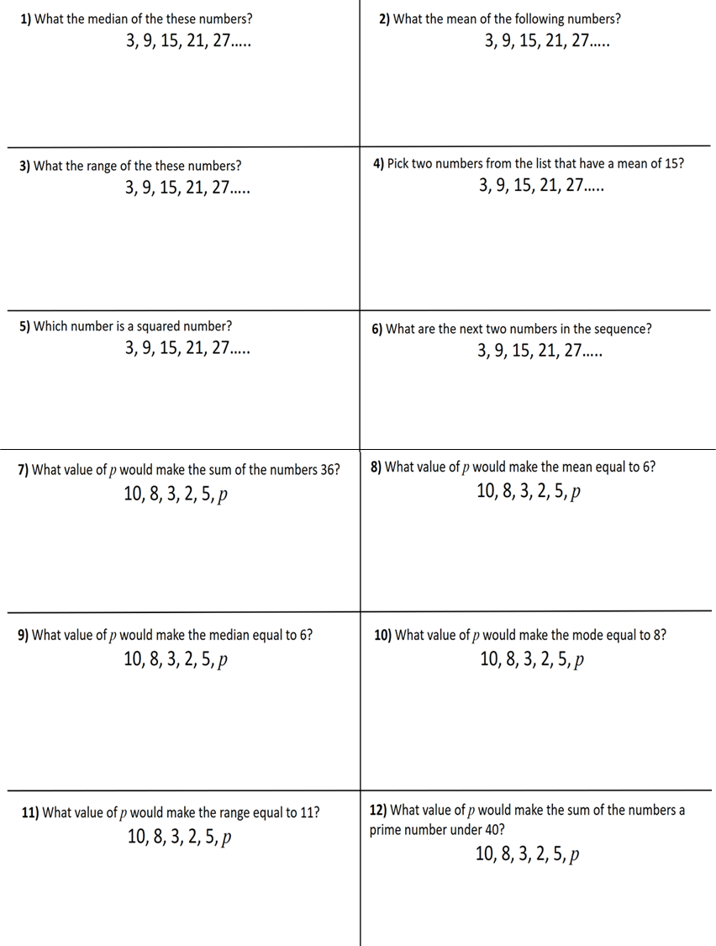


Slide 2
ANSWERS

Slide 3
1) What the median of the these numbers?
3, 9, 15, 21, 27…..
2) What the mean of the following numbers?
3, 9, 15, 21, 27…..
15
15
3) What the range of the these numbers?
3, 9, 15, 21, 27…..
4) Pick two numbers from the list that have a mean of 15?
3, 9, 15, 21, 27…..
21 and 9
or
27 and 3
24
5) Which number is a squared number?
3, 9, 15, 21, 27…..
6) What are the next two numbers in the sequence?
3, 9, 15, 21, 27…..
9
33, 39

Slide 4
7) What value of p would make the sum of the numbers 36?
10, 8, 3, 2, 5, p
8) What value of p would make the mean equal to 6?
10, 8, 3, 2, 5, p
8
8
9) What value of p would make the median equal to 6?
10, 8, 3, 2, 5, p
10) What value of p would make the mode equal to 8?
10, 8, 3, 2, 5, p
2, 3, 5, 7, 8, 10
8
7
11) What value of p would make the range equal to 11?
10, 8, 3, 2, 5, p
12) What value of p would make the sum of the numbers a prime number under 40?
10, 8, 3, 2, 5, p
-1 or 13
1, 3, 9

