Slide 1
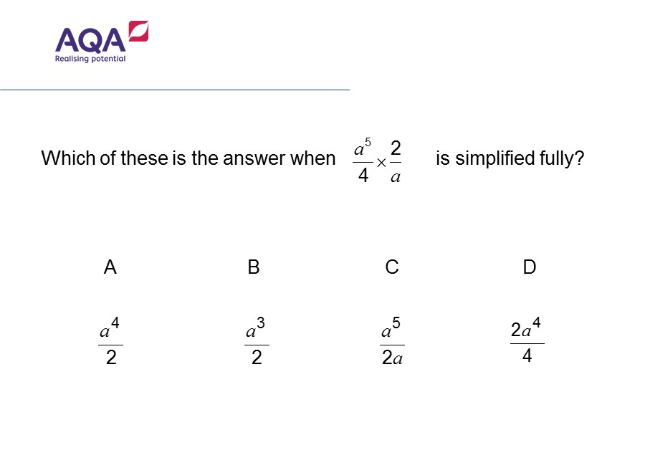
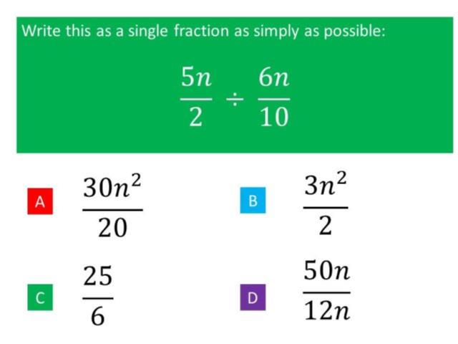
Worst answered question?
Most common wrong answer?

Slide 2
ANSWERS

Slide 3
Worst answered question?

Slide 4
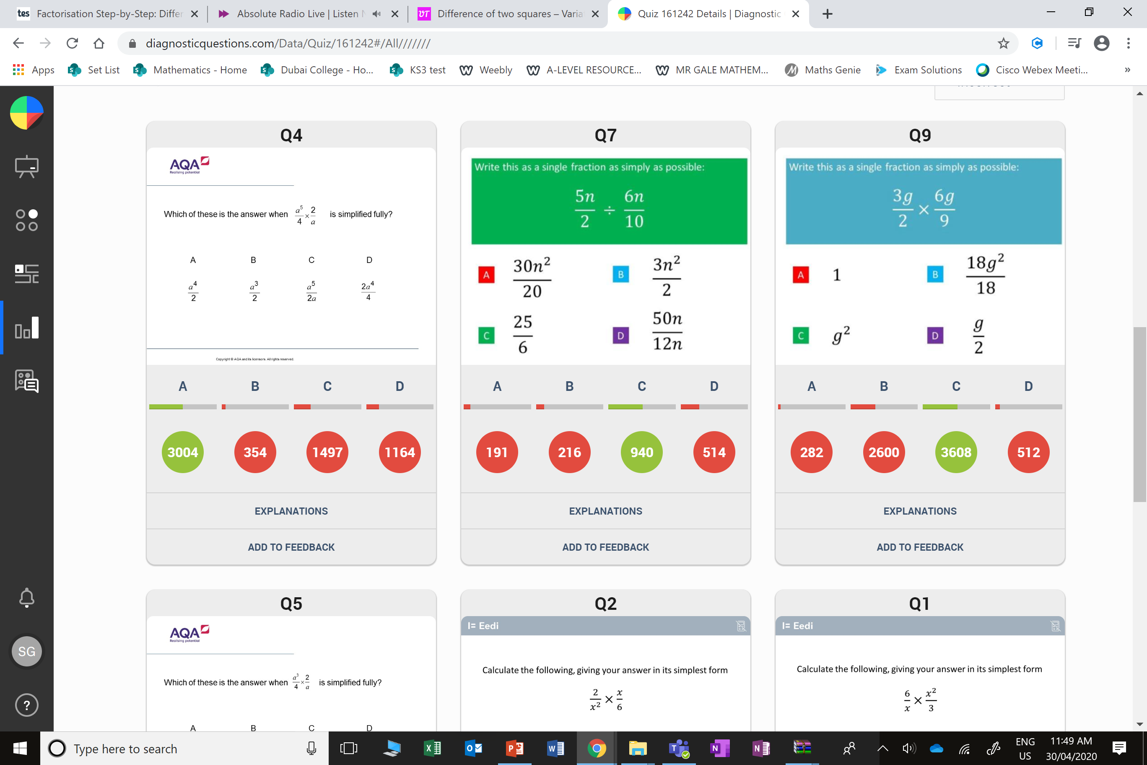
C
The student
has not
simplified fully.

Slide 5
D
They divided correctly but did not simplify.

