Slide 1
Functions and Graphs
Domain and Range
Chapter 2
(Part 2 of 6)

Slide 2
A mapping is something which
maps one set of numbers to another.
f (x) = 2x
x
y
3
6
0.5
1

Slide 3
There are two different type of functions you should know about.
One to One
Many to One

Slide 4
Function: One to One
One value of x lead to one value of y
f (x) = 2x
x
y
-3
-6
2.5
5

Slide 5
Function: One to One
One value of x lead to one value of y
y
x

Slide 6
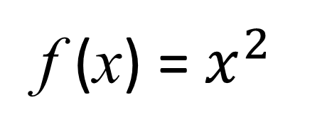
Function: Many to One
Many values of x can lead to one value of y
f (x) = $x^{2}$
x
y
3
9
-3

Slide 7
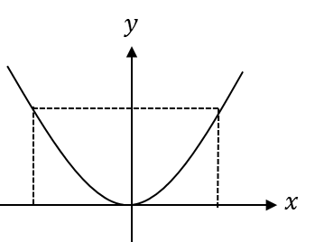
Function: Many to One
Many values of x can lead to one value of y

Slide 8
One to Many are not
considered functions.
One input should only ever produce one output.

Slide 9
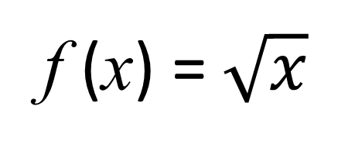
Not a Function: One to Many
f (x) = $\sqrt{x}$
x
y
9
3
-3

Slide 10
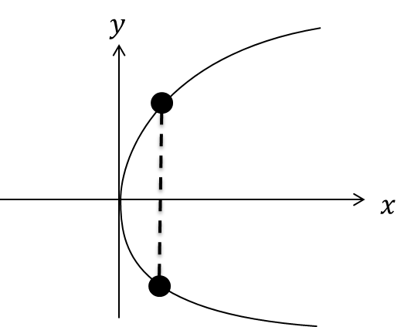
Not a Function: One to Many

Slide 11
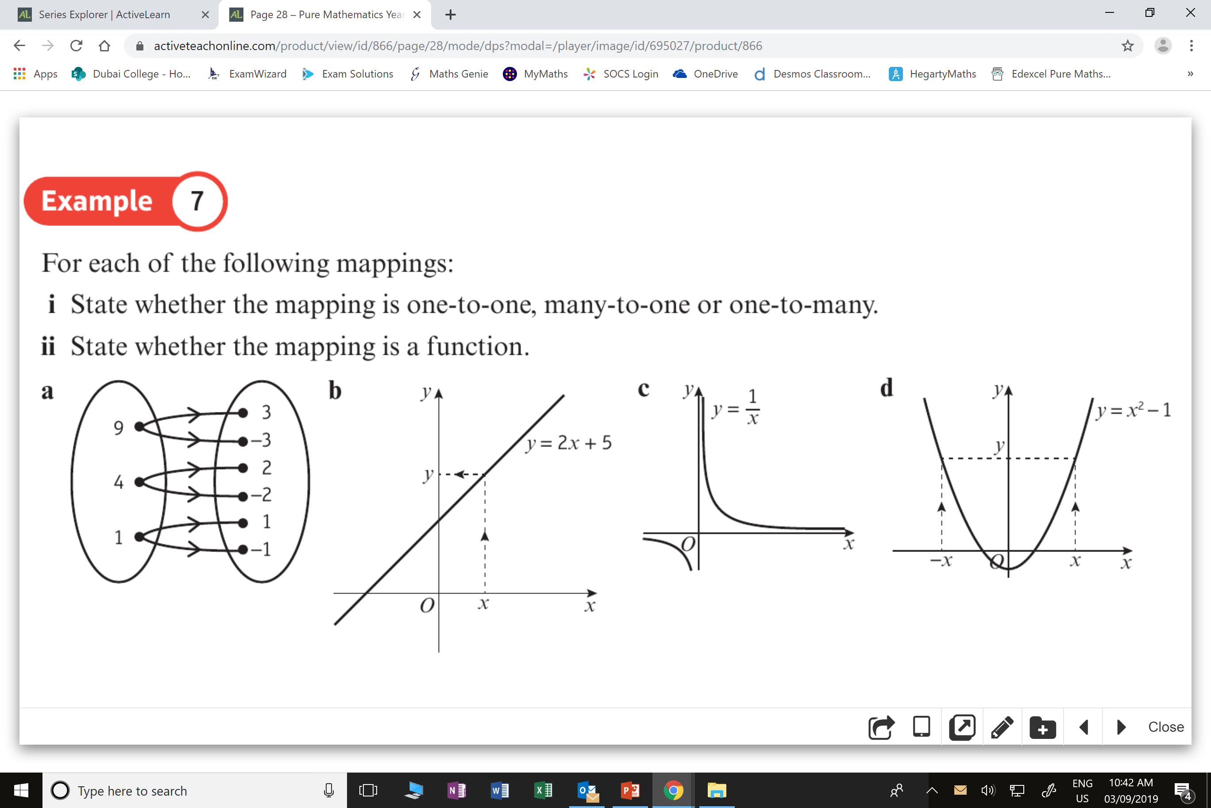
Function or Not a Function?
Not a Function
(One to Many)

Slide 12
Function or Not a Function?
Function
(One to One)

Slide 13
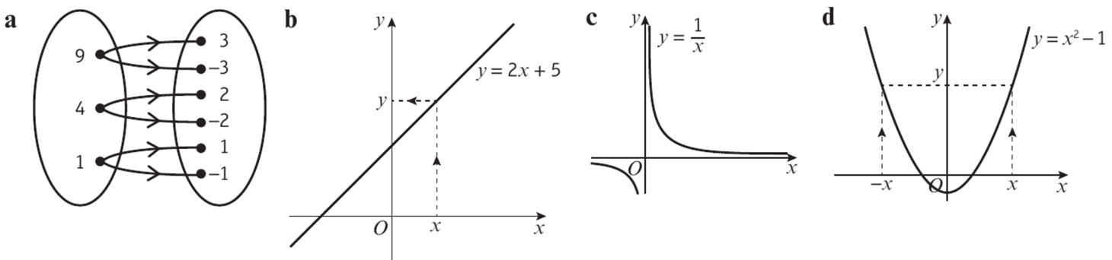
Function or Not a Function?
Not a function
x = 0 does not
get mapped

Slide 14
Function or Not a Function?
Function
(Many to One)

Slide 15
Domain and Range
Range is the possible y values
of a function.
Domain is the possible x values
of a function.

Slide 16
Domain and Range
Often the best way to determine the domain and range of a function
is to sketch a graph.

Slide 17
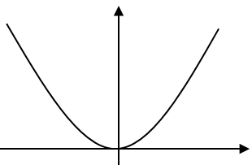
Range is the possible values of y of a function.
y
25
Range
0 ≤ y ≤ 25
x

Slide 18
Domain is the possible values of x of a function.
y
25
Domain
-5 ≤ x ≤ 5
x
-5
5

Slide 19
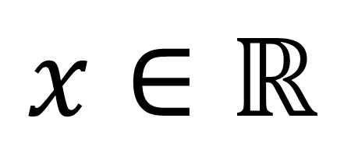
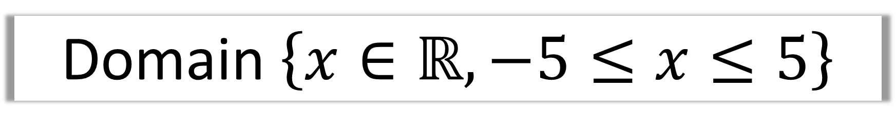
Notation
Domain $\left\{x∈ℝ, −5≤x≤5\right\}$
$$x∈ℝ$$
x includes all real numbers (negative and positive numbers)

Slide 20
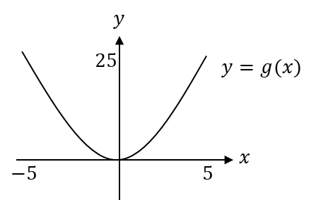
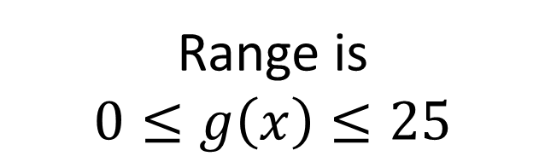
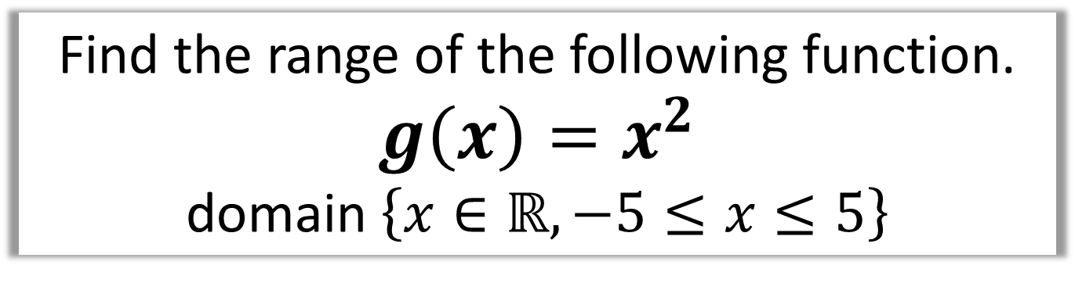
Find the range of the following function.
$g\left(x\right)=x^{2}$
domain $\left\{x∈ℝ, −5≤x≤5\right\}$
Range is
$$0≤g\left(x\right)≤25$$

Slide 21
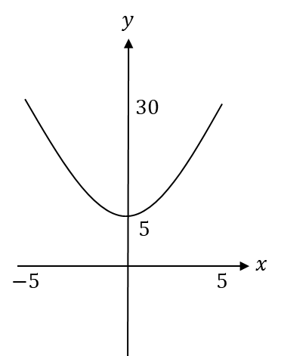
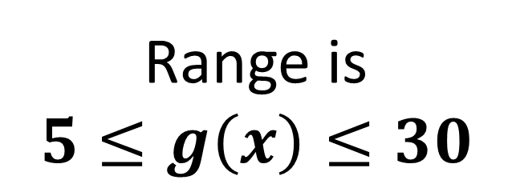
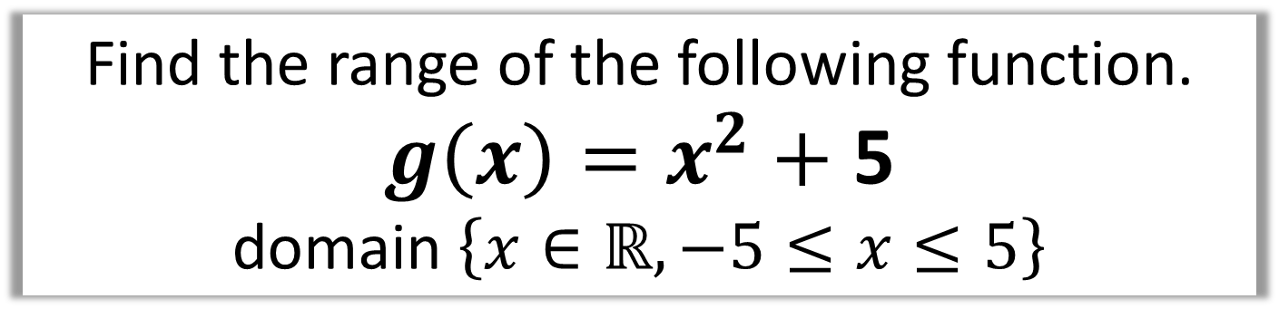
Find the range of the following function.
$g\left(x\right)=x^{2}+$ 5
domain $\left\{x∈ℝ, −5≤x≤5\right\}$
Range is
$$5≤g\left(x\right)≤30$$

Slide 22
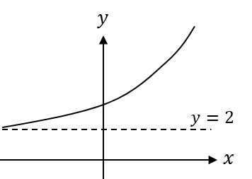
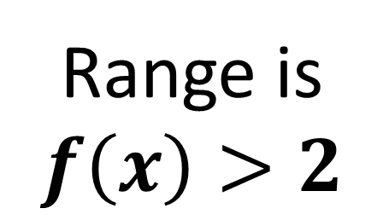
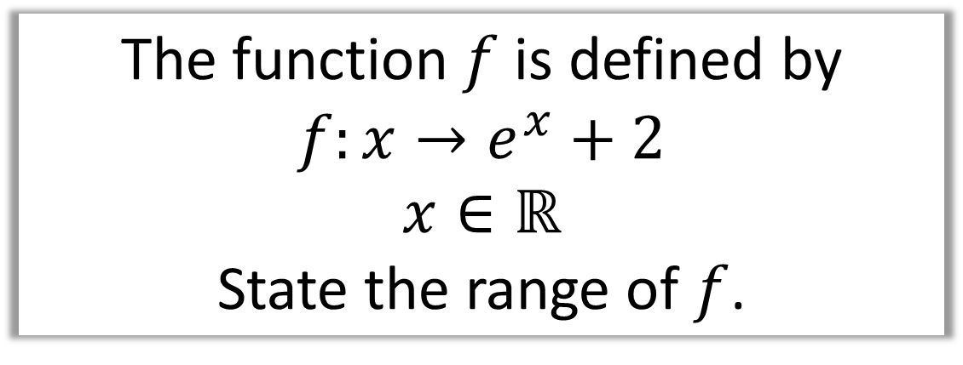
The function $f$ is defined by
$$f:x→e^{x}+2$$
$$x∈ℝ$$
State the range of $f$.
Range is
$$f\left(x\right)>2$$

Slide 23
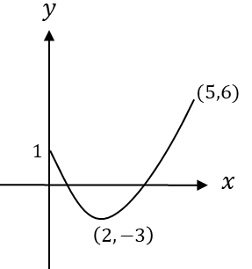
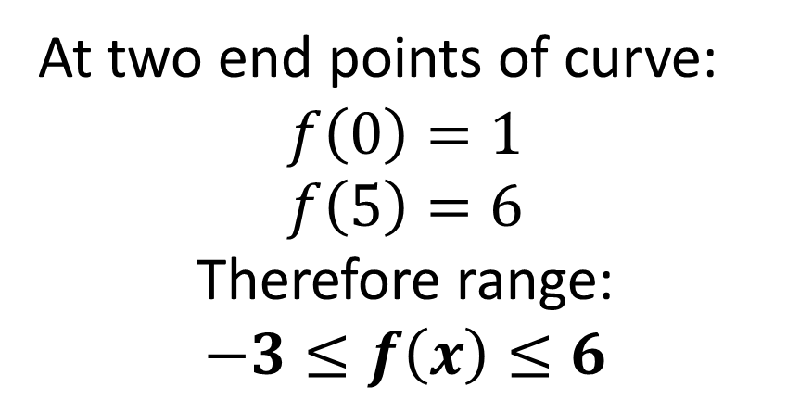
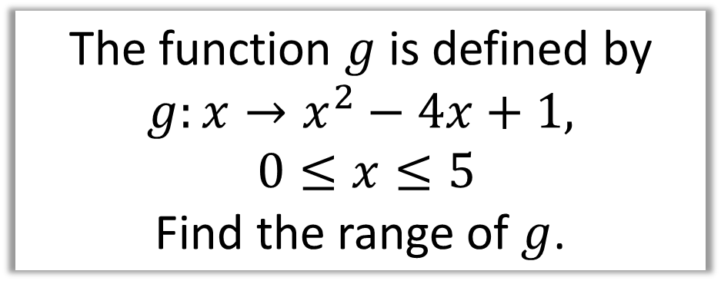
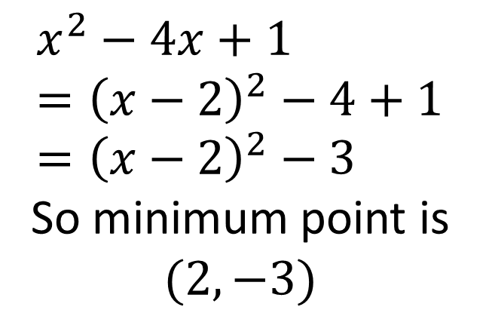
The function $g$ is defined by
$$g:x→x^{2}−4x+1,$$
$$0≤x≤5$$
Find the range of $g$.
$$x^{2}−4x+1 \\ ={\left(x−2\right)}^{2}−4+1 \\ ={\left(x−2\right)}^{2}−3$$
So minimum point is $(2,−3)$
At two end points of curve:
$$f\left(0\right)=1 \\ f\left(5\right)=6$$
Therefore range:
$$−3≤f\left(x\right)≤6$$

Slide 24
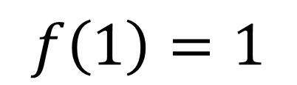
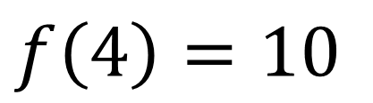
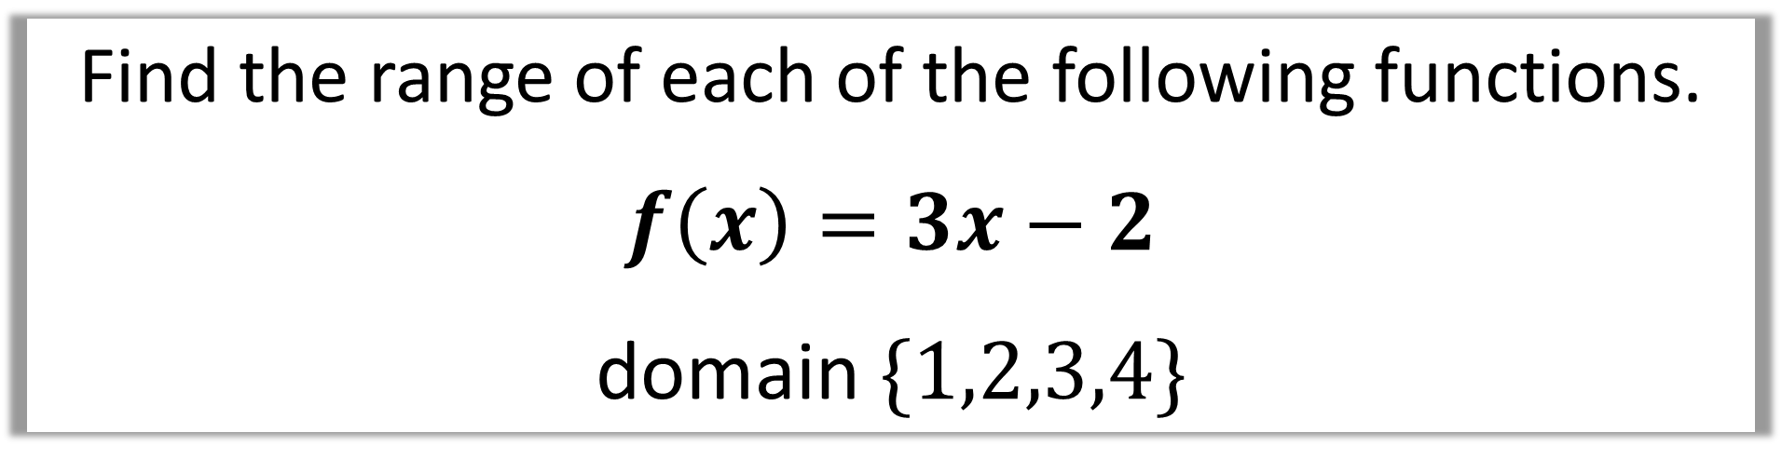
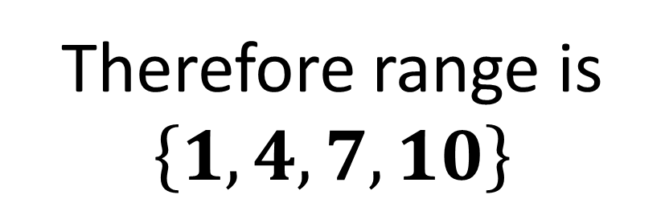
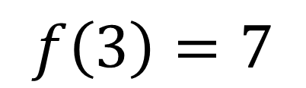
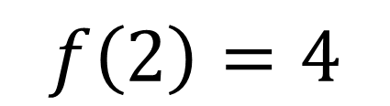
Find the range of each of the following functions.
$f\left(x\right)=3x−2$
domain $\{1,2,3,4\}$
$$f\left(1\right)=1$$
$$f\left(2\right)=4$$
Therefore range is
$$\left\{1,4,7,10\right\}$$
$$f\left(3\right)=7$$
$$f\left(4\right)=10$$

Slide 25
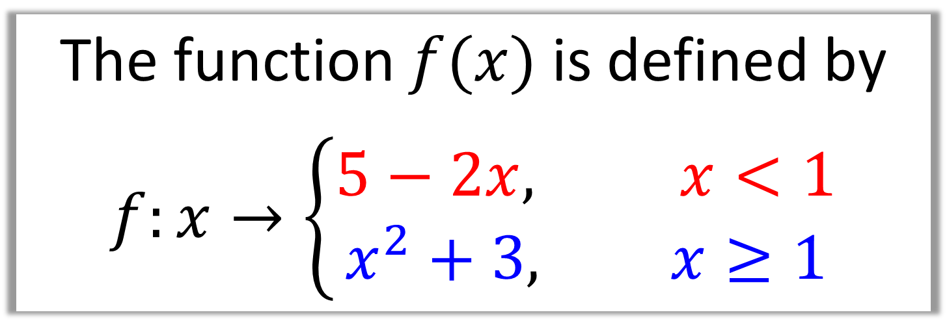
A ‘piecewise function’
is one which made up of different functions.
The function $f(x)$ is defined by
$$f:x→\left\{\begin{aligned}5−2x, x<1 \\ x^{2}+3, x≥1\end{aligned}\right.$$

Slide 26



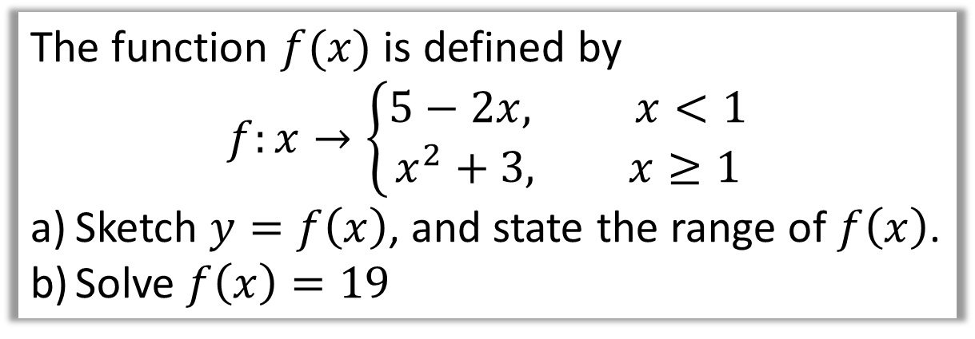





The function $f(x)$ is defined by
$$f:x→\left\{\begin{aligned}5−2x, x<1 \\ x^{2}+3, x≥1\end{aligned}\right.$$
Sketch $y=f\left(x\right)$, and state the range of $f\left(x\right)$.
Solve $f\left(x\right)=19$
$$y$$
a)
$$y=5−2x$$
$$y=x^{2}+3$$
$$5$$
$$4$$
$$3$$
$$x$$
$$1$$

Slide 27



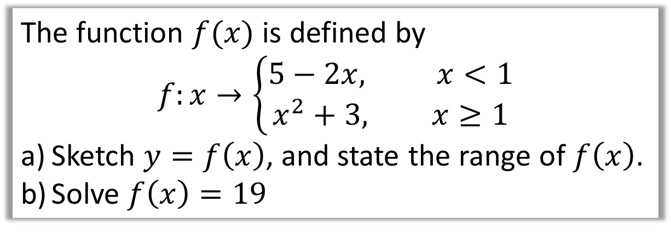
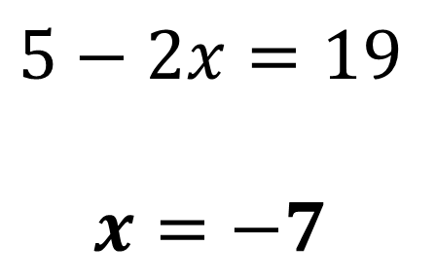

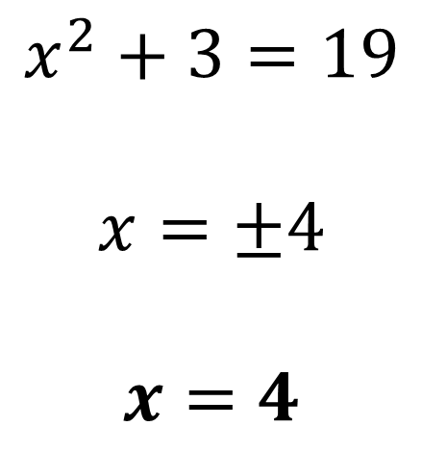




The function $f(x)$ is defined by
$$f:x→\left\{\begin{aligned}5−2x, x<1 \\ x^{2}+3, x≥1\end{aligned}\right.$$
Sketch $y=f\left(x\right)$, and state the range of $f\left(x\right)$.
Solve $f\left(x\right)=19$
b)
$$y$$
$$y=x^{2}+3$$
$$x^{2}+3=19$$
$$x=±4$$
$$x=4$$
$$5−2x=19$$
$$x=−7$$
$$19$$
$$5$$
$$4$$
$$3$$
$$1$$
$$x$$

