Slide 1
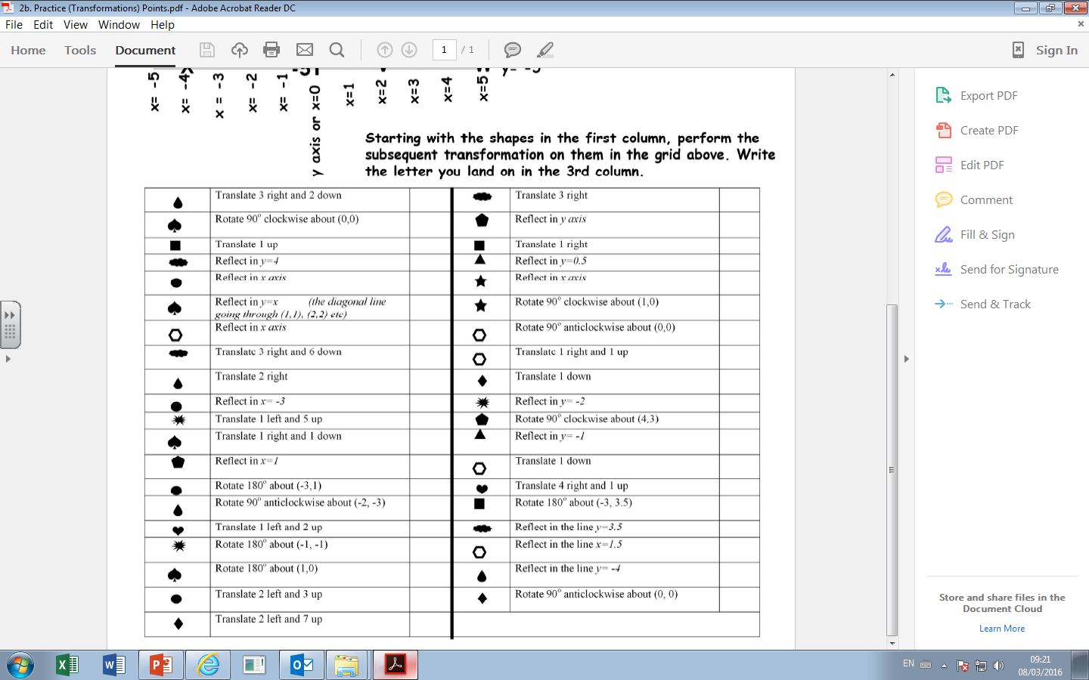
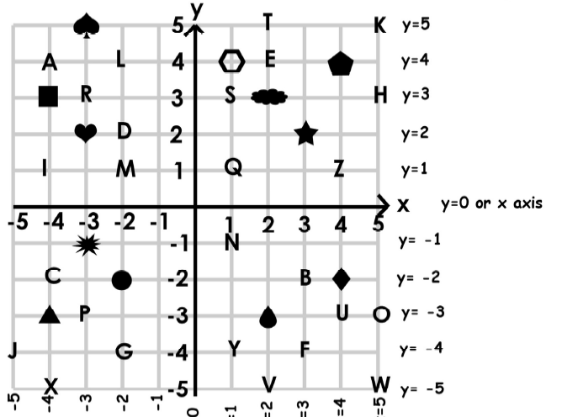

Slide 2
ANSWERS

Slide 3
What do you call a man who has a rabbit up his jumper?
Warren!

