Slide 1
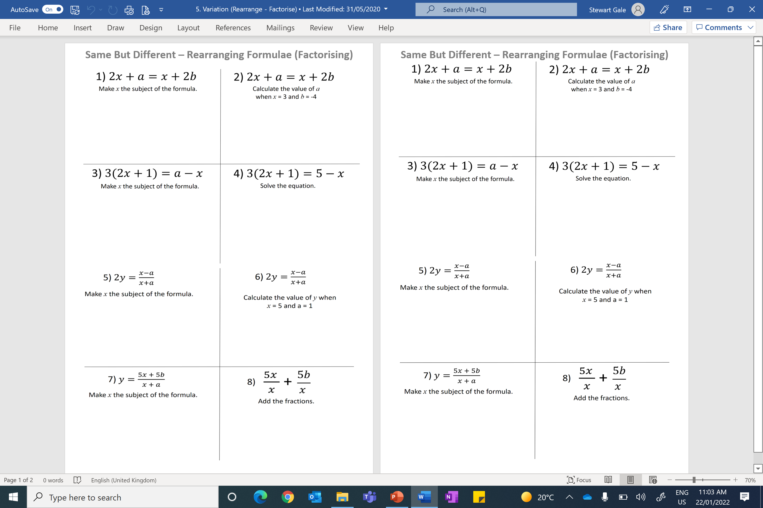

Slide 2
ANSWERS

Slide 3

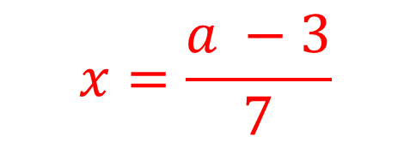
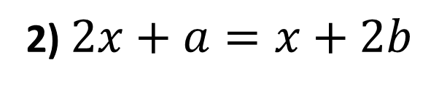


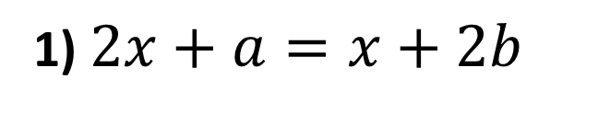



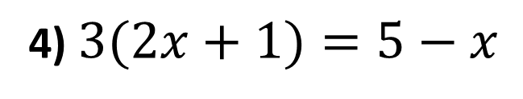


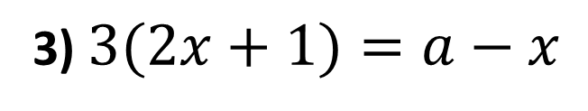


1) $2x+a=x+2b$
2) $2x+a=x+2b$
Make x the subject of the formula.
Calculate the value of a
when x = 3 and b = -4
$$2x−x=2b −a$$
$$a=−x+2b$$
$$x=2b −a$$
$$a=−3−8$$
$$a=−11$$
3) $3(2x+1)=a−x$
4) $3(2x+1)=5−x$
Make x the subject of the formula.
Solve the equation.
$$6x+3=a −x$$
$$6x+3=5 −x$$
$$7x=a −3$$
$$7x=2$$
$$x=\frac{a −3}{7}$$
$$x=3.5$$

Slide 4



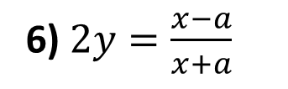

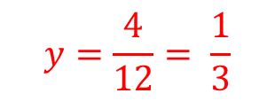

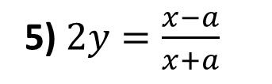

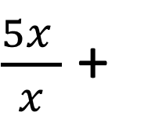
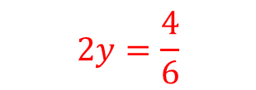

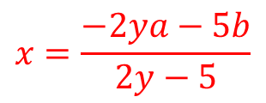

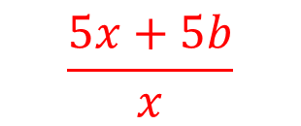
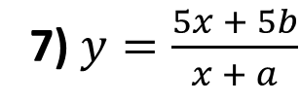
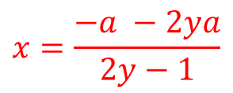

5) $2y=\frac{x−a}{x+a}$
6) $2y=\frac{x−a}{x+a}$
Make x the subject of the formula.
Calculate the value of y when
x = 5 and a = 1
$$2y(x+a)=x −a$$
$$x=\frac{−a −2ya}{2y−1}$$
$$2y=\frac{4}{6}$$
$$2yx+2ya=x −a$$
$$2yx−x=−a −2ya$$
$$y=\frac{4}{12}= \frac{1}{3}$$
$$x(2y−1)=−a −2ya$$
7) $y=\frac{5x + 5b}{x + a}$
$\frac{5x }{x}$ +
$$\frac{5b}{x }$$
8)
Make x the subject of the formula.
Add the fractions.
$$y(x+a)=5x −5b$$
$$x=\frac{−2ya−5b}{2y−5}$$
$$\frac{5x+5b}{x}$$
$$2yx+2ya=5x −5b$$
$$2yx−5x=−2ya −5b$$
$$x(2y−5)=−2ya −5b$$

