Slide 1
LO: Expanding
3 Brackets

Slide 2
Expand and Simplify.
(x – 2)²
(x – 2)(x – 2) =
x² – 4x + 4

Slide 3
Expand and Simplify.
(2x – 2)(x – 7) =
2x² – 14x – 2x + 14 =
2x² – 16x + 14

Slide 4
Expand and Simplify.
(x – y)(x – y) =
x² – xy – xy + y² =
x² – 2xy + y²

Slide 5
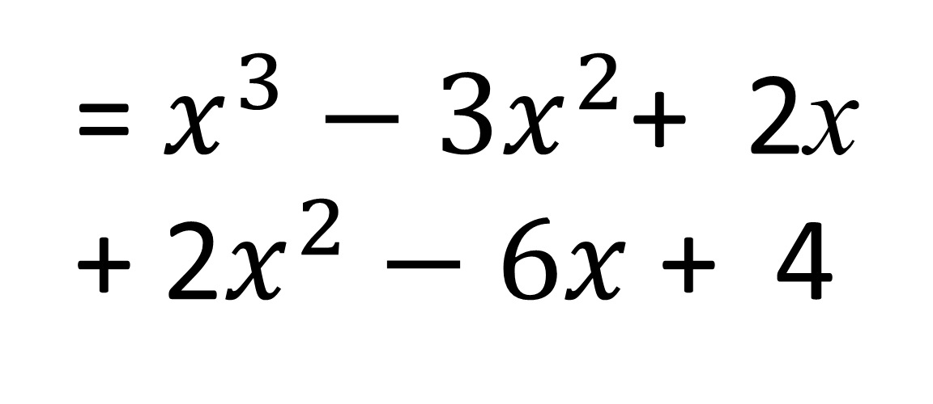
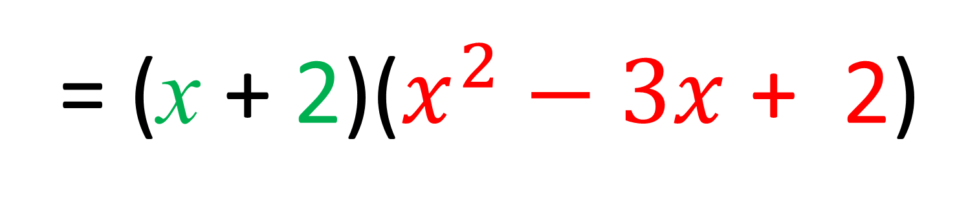
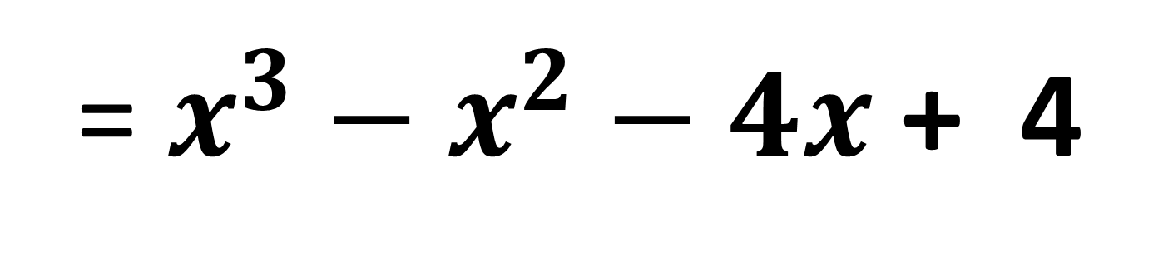
Expand and Simplify (x – 1)(x – 2)(x + 2)
= (x + 2)($x^{2}−3x$ + 2)
= $x^{3}−3x^{2}$+ 2x
+ ${\text{2}x}^{2}−6x$ + 4
= $x^{3}−x^{2}−4x$ + 4

Slide 6
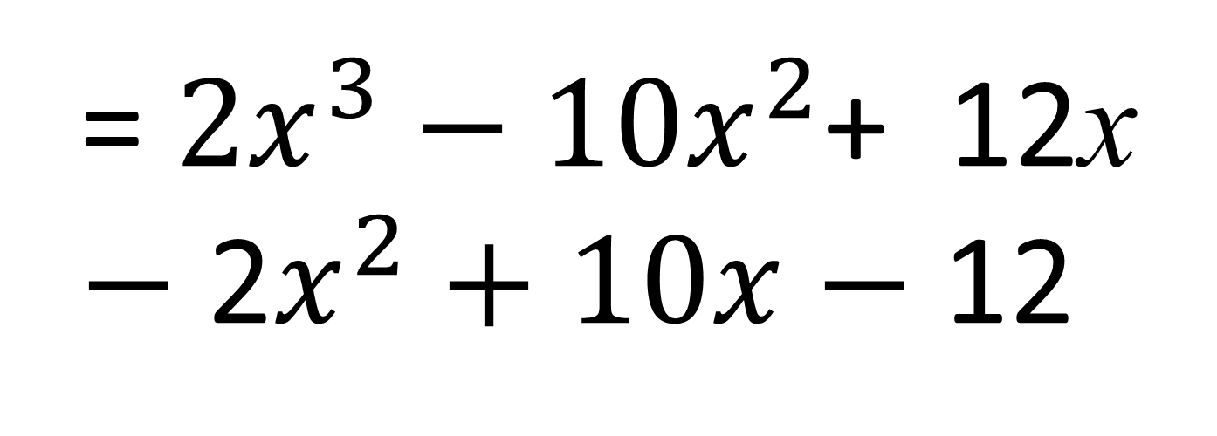
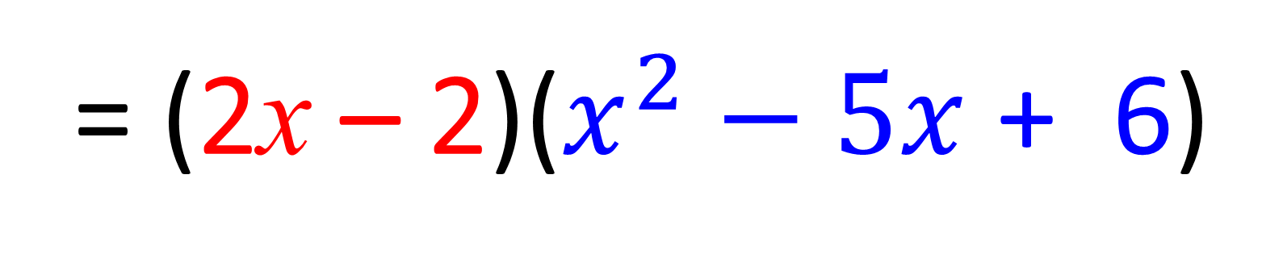
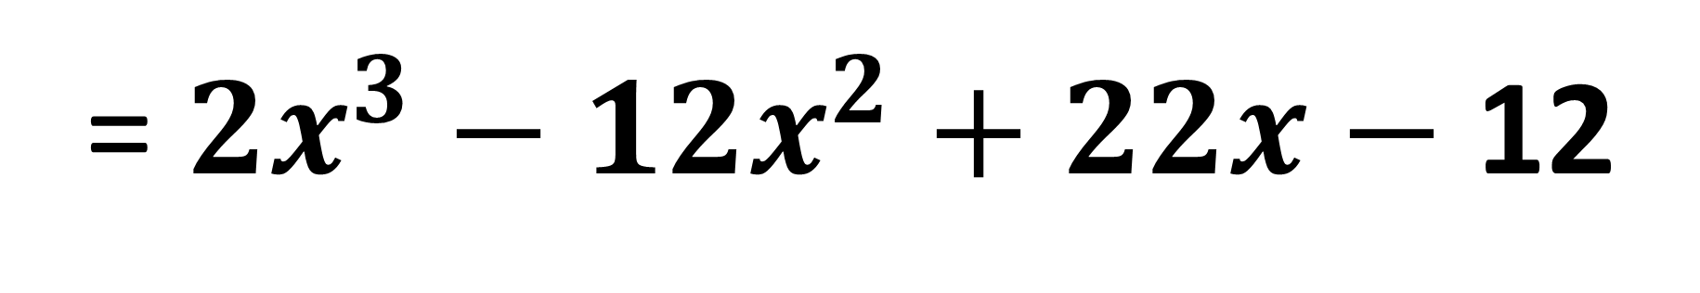
Expand and Simplify (x – 3)(x – 2)(2x – 2)
= (2x – 2)($x^{2}−5x$ + 6)
= ${2x}^{3}−10x^{2}$+ 12x
$−$ ${\text{2}x}^{2}+10x$ $−$ 12
= ${2x}^{3}−{12x}^{2}+22x$ $−$ 12

