Slide 1
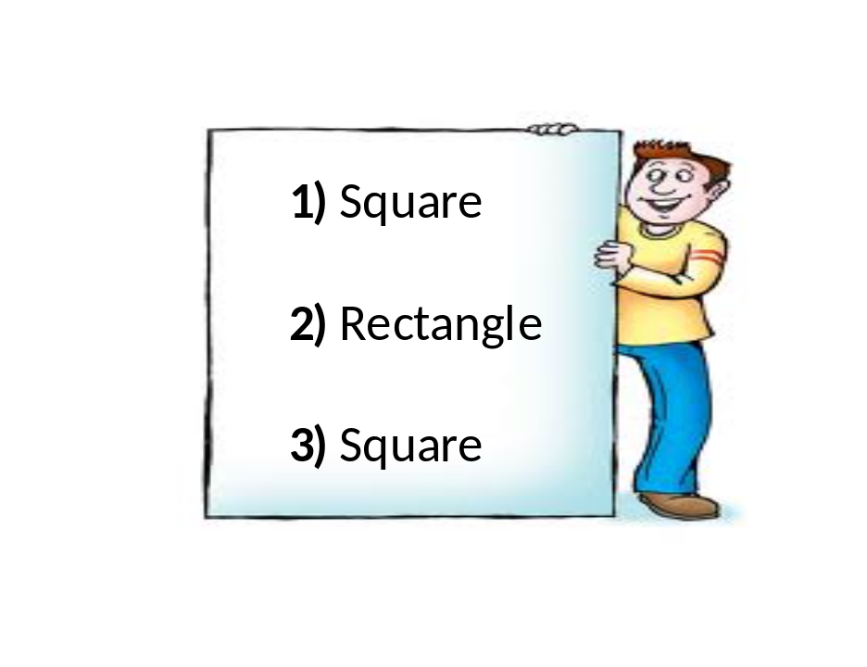
What polygon am I?
You will be given 3 glues (1 at a time) to guess the polygon.
After each clue you can stick with your choice or change you mind.
After the clues have been give you score 1 point
for every time you wrote down the correct answer.
There are 6 polygons to guess.
The person with the most points wins.

Slide 2

Round 1
Rhombus
Square
Parallelogram
Rectangle
Pentagon
Trapezium
Kite
Decagon
Triangle
Heptagon
Regular Octagon
 | What polygon am I?
Clue 1: | I like to go quad biking
Clue 2: | All my angles are right angles
Clue 3: | All my sides are equal
Answer: | Square

Slide 3
Round 2
Rhombus
Square
Parallelogram
Rectangle
Pentagon
Trapezium
Kite
Decagon
Triangle
Heptagon
Regular Octagon
 | What polygon am I?
Clue 1: | I have one line of symmetry
Clue 2: | None of my sides are parallel
Clue 3: | I like it when it is windy
Answer: | Kite

Slide 4
Round 3
Rhombus
Square
Parallelogram
Rectangle
Pentagon
Trapezium
Kite
Decagon
Triangle
Heptagon
Regular Octagon
 | What polygon am I?
Clue 1: | I have 5 lines of symmetry.
Clue 2: | I am shaped like a 50p coin.
Clue 3: | They named a building after me
Answer: | Pentagon

Slide 5
Round 4
Rhombus
Square
Parallelogram
Rectangle
Pentagon
Trapezium
Kite
Decagon
Triangle
Heptagon
Regular Octagon
 | What polygon am I?
Clue 1: | All my sides are the same length.
Clue 2: | I have 2 lines of symmetry.
Clue 3: | I am a girls best friend.
Answer: | Rhombus

Slide 6
Round 5
Rhombus
Square
Parallelogram
Rectangle
Pentagon
Trapezium
Kite
Decagon
Triangle
Heptagon
Regular Octagon
 | What polygon am I?
Clue 1: | Your house needs me when it rains.
Clue 2: | I have only one set of parallel sides.
Clue 3: | The parallel sides can not be the same length.
Answer: | Trapezium

Slide 7
Round 6
Rhombus
Square
Parallelogram
Rectangle
Pentagon
Trapezium
Kite
Decagon
Triangle
Heptagon
Regular Octagon
 | What polygon am I?
Clue 1: | My opposite sides are equal.
Clue 2: | Not all my sides and angles are equal.
Clue 3: | I have two pairs of parallel sides.
Answer: | Parallelogram

