Slide 1
LO: Negative
Numbers

Slide 2
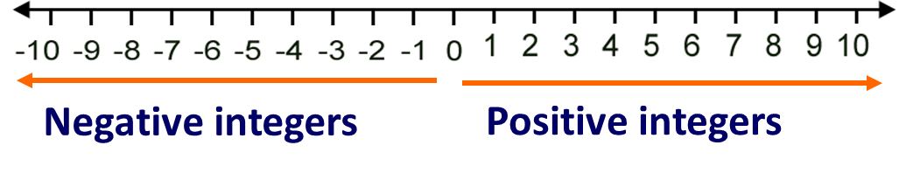
Is zero negative or positive?
–
+

Slide 3
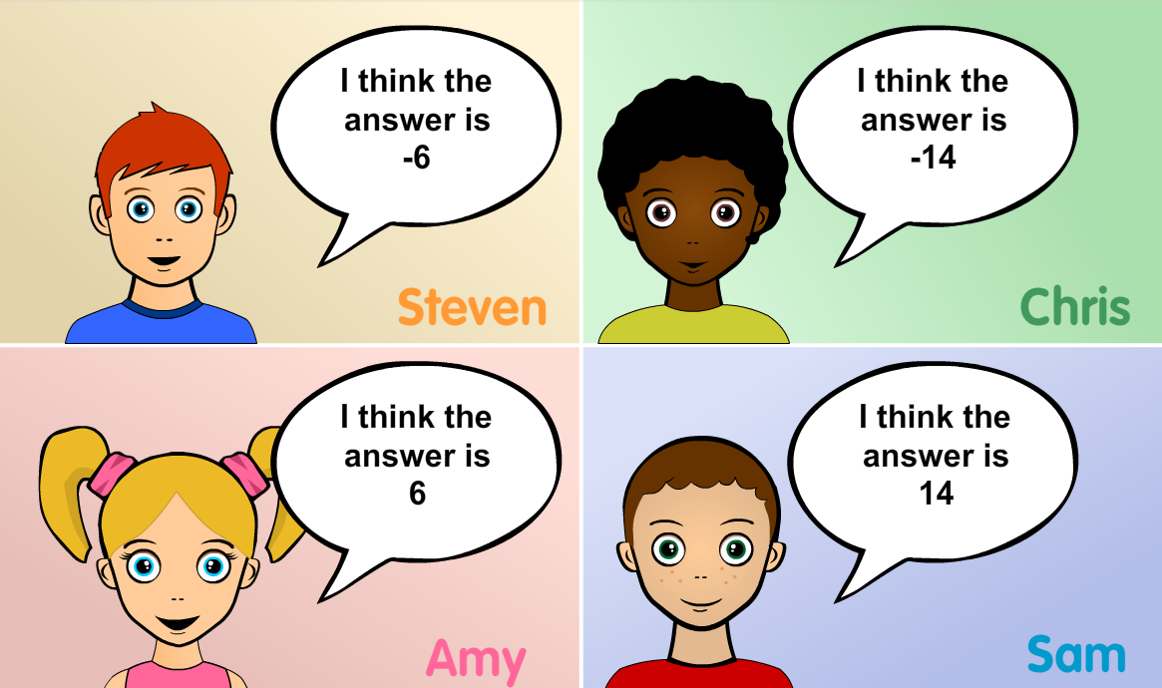
What is minus 10 takeaway 4? Who is right and Why?

Slide 4
What is 10 takeaway negative 4? Who is right and Why?

Slide 5


–2 + 5 =
3
+ 5
-2
3

Slide 6
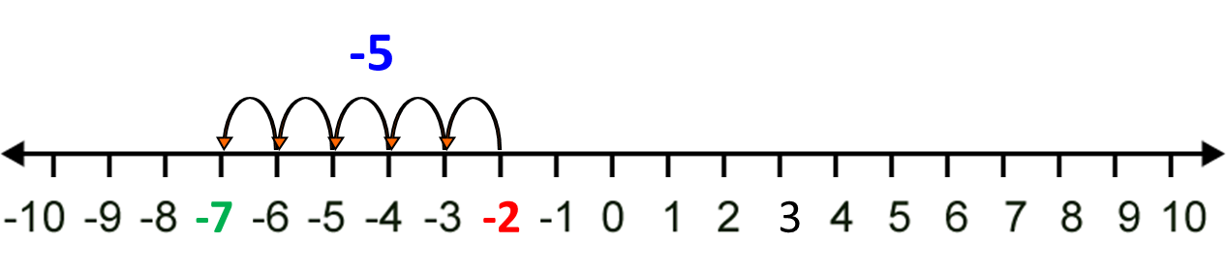
–2 – 5 =
–7

Slide 7
–2 – –5 =
3
+ 5
-2
3

Slide 8
2 – –5 =
7
+ 5
2
7

Slide 9
Adding and Subtracting
Positive and Positive replace with Positive
Negative and Negative replace with Positive
Positive and Negative replace with Negative
Negative and Positive replace with Negative

Slide 10
–7 – –5 =
–2
–7 + + 5 =
–2

Slide 11
–7 – + 5 =
–12
–7 – + 5 =
–12

Slide 12
–7 + –5 =
–12
–7 – + 5 =
–12

Slide 13
Multiplying and Dividing
Positive x Positive = Positive
Negative x Negative = Positive
Positive x Negative = Negative
Negative x Positive = Negative

Slide 14
–3 x –4 =
12

Slide 15
–3 x +4 =
–12

Slide 16
(–4)² =
16

Slide 17
–2 x –3 x 3 =
18

Slide 18
–2 x –5 x –3 =
–30

Slide 19
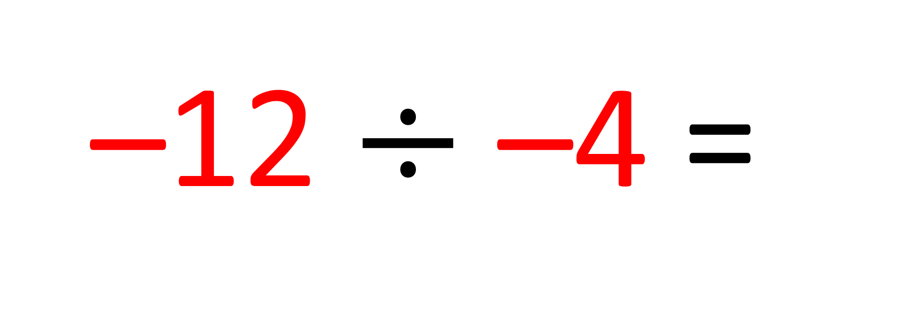
–12 $÷$ –4 =
3

Slide 20
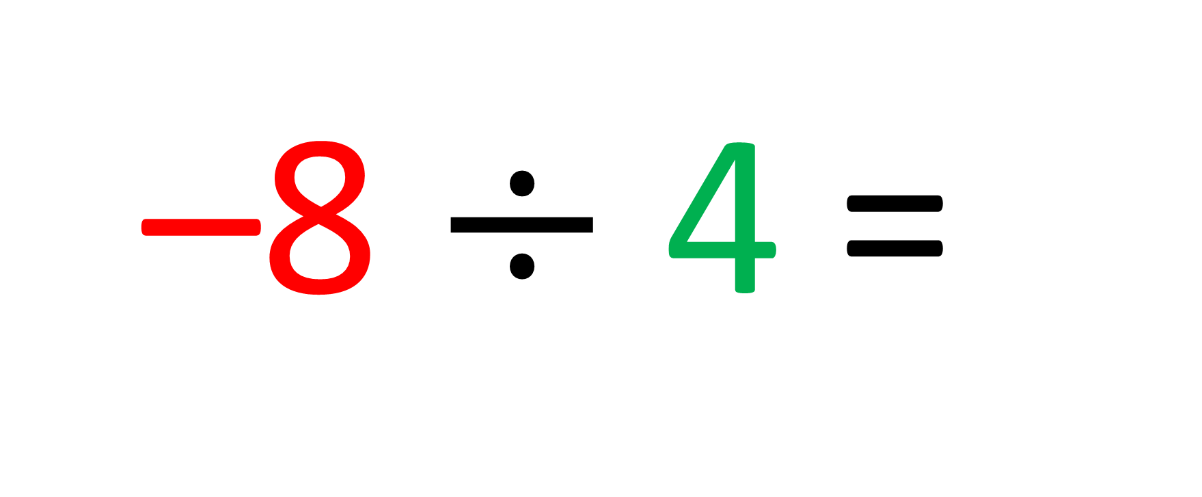
–8 $÷$ 4 =
–2

