Slide 1
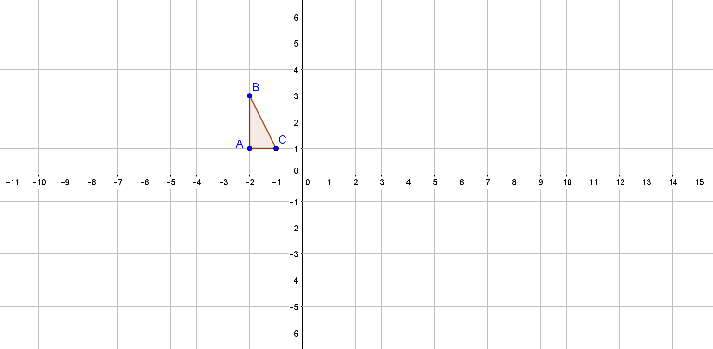
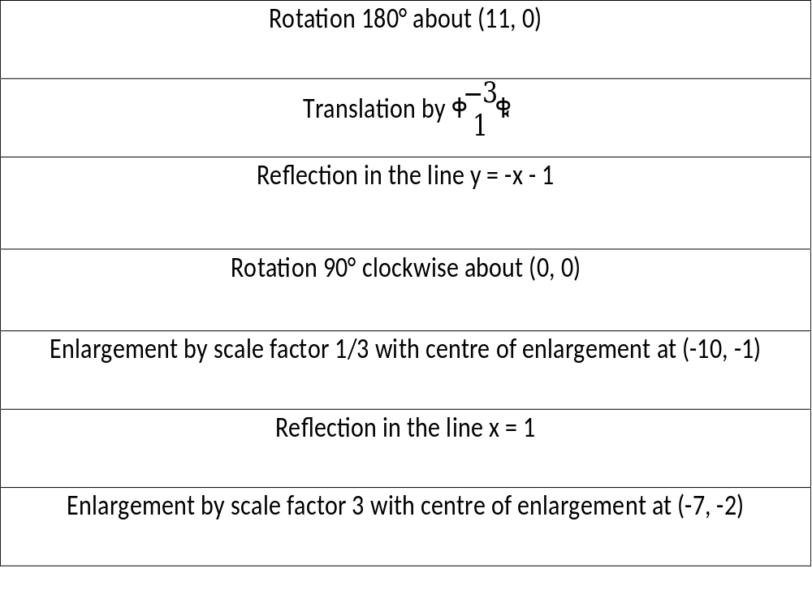
Combined Transformations Challenge
Starting from triangle ABC, can you work out the order for the 7 transformations
below so that the final transformation will return you to the original triangle ABC.
You are not allowed to extend the grid!

Slide 2
ANSWERS

Slide 3
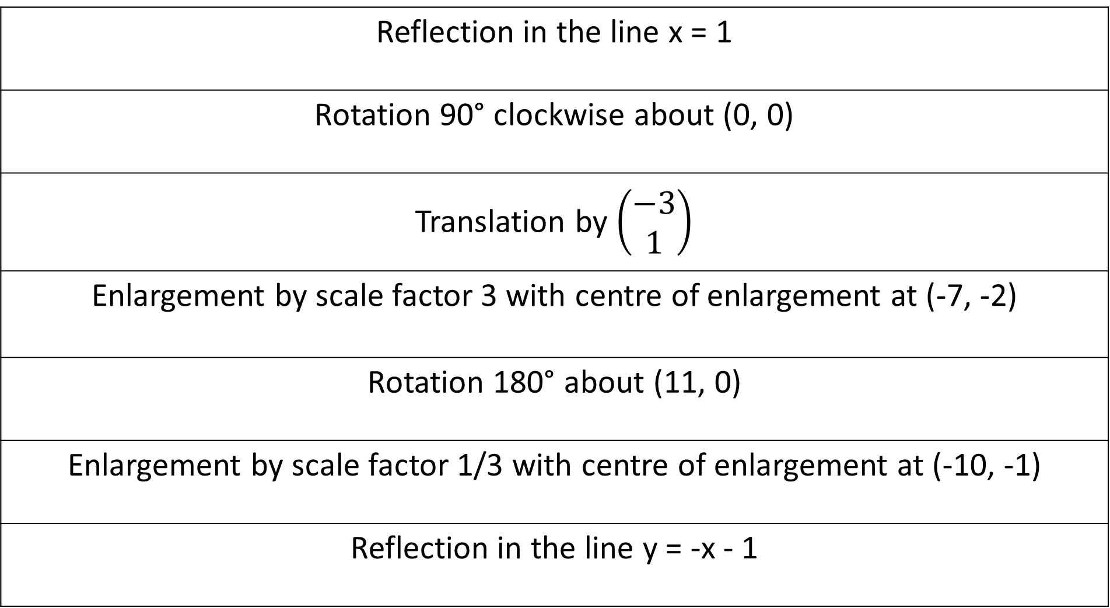
Reflection in the line x = 1
Rotation 90° clockwise about (0, 0)
Translation by $\left(\begin{matrix}−3 \\ 1\end{matrix}\right)$
Enlargement by scale factor 3 with centre of enlargement at (-7, -2)
Rotation 180° about (11, 0)
Enlargement by scale factor 1/3 with centre of enlargement at (-10, -1)
Reflection in the line y = -x - 1

