Slide 1
FM: Algebraic
Long Division

Slide 2

Learn how to do
algebraic long division
by clicking the symbol below.

Slide 3
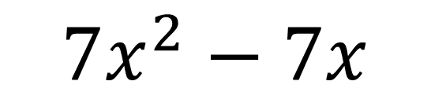
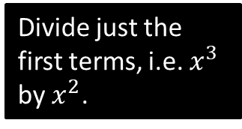
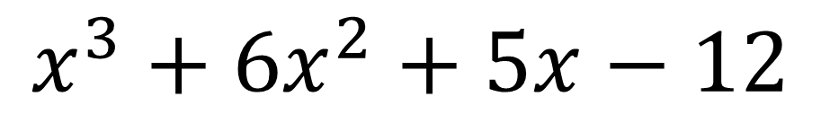
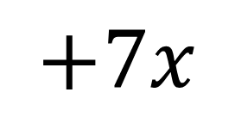

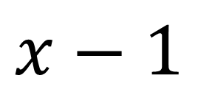
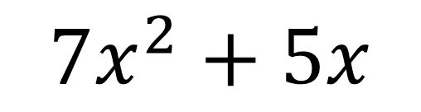
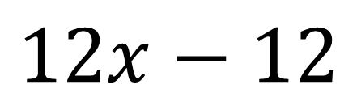
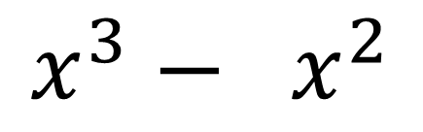
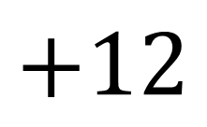
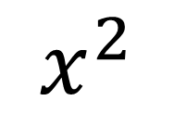
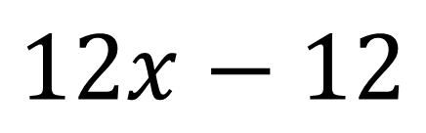
$$x^{2}$$
$$+7x$$
$$+12$$
$$x−1$$
$$x^{3}+6x^{2}+5x−12$$
$$x^{3}− x^{2}$$
Divide just the first terms, i.e. $x^{3}$ by $x^{2}$.
$$7x^{2}+5x$$
$$7x^{2}−7x$$
$$12x−12$$
$$12x−12$$
$$0$$

Slide 4
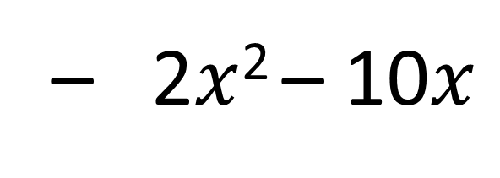
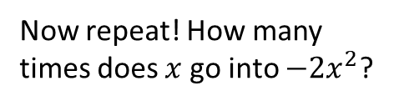
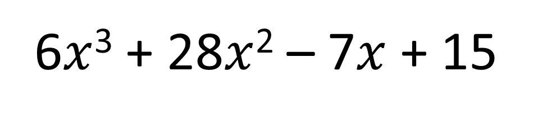
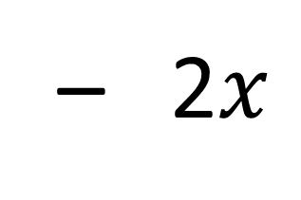
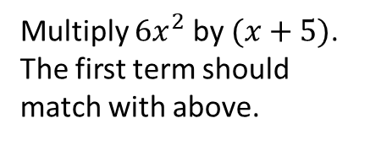
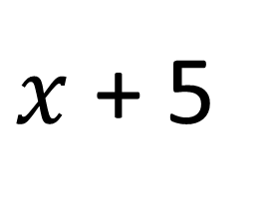
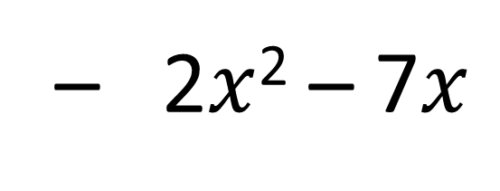

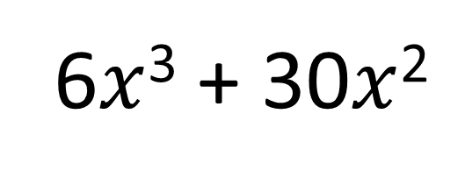
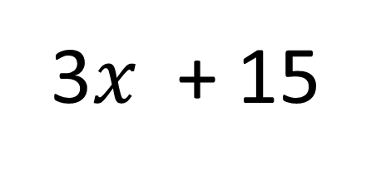
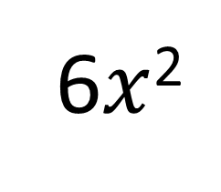
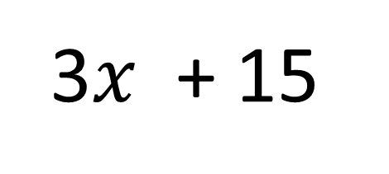
How many times does $x$ go into $6x^{3}$?
Now repeat! How many times does $x$ go into $−2x^{2}$?
6$x$²
– 2$x$
+ 3
$x$ + 5
6$x$³ + 28$x$² – 7$x$ + 15
6$x$³ + 30$x$²
Subtract and carry down next term.
Multiply $6x^{2}$ by $(x+5)$. The first term should match with above.
– 2$x$² – 7$x$
– 2$x$² – 10$x$
3$x$ + 15
3$x$ + 15
This is the remainder.
0

Slide 5
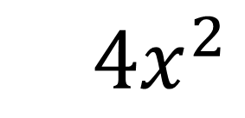
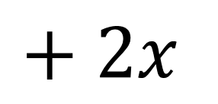
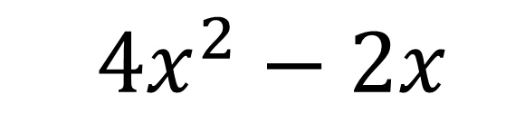
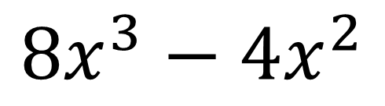
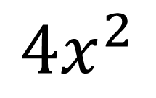

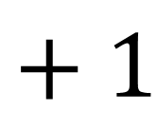
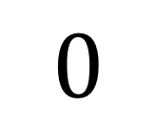
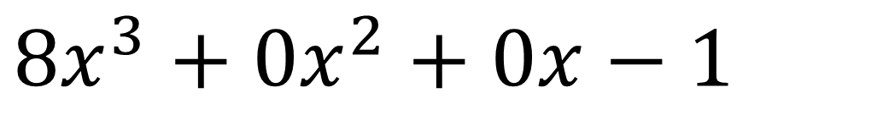
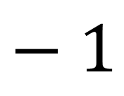
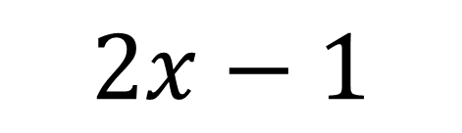
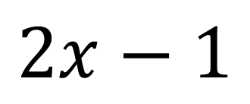

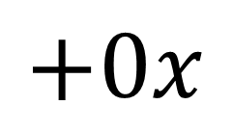
Divide $8x^{3}−1$ by $2x−1$.
$$4x^{2}$$
$$+ 2x$$
$$+ 1$$
$$2x−1$$
$$8x^{3}+0x^{2}+0x−1$$
$$8x^{3}−4x^{2}$$
$4x^{2}$
$$+0x$$
$4x^{2}−2x$
$$2x$$
$$− 1$$
$$2x−1$$
$$0$$

Slide 6
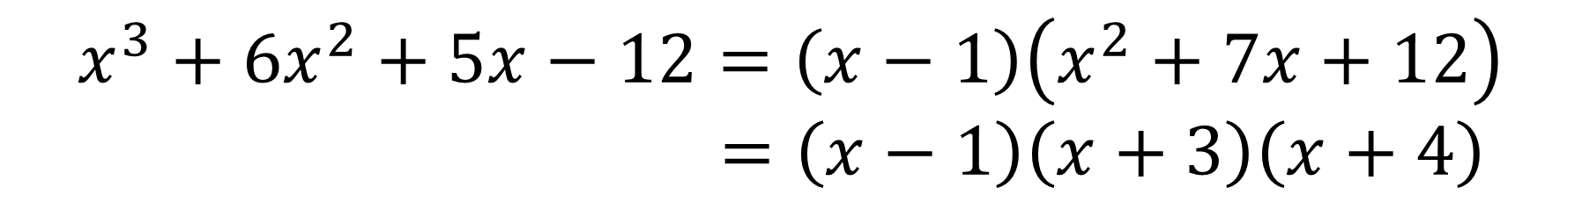
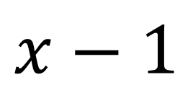
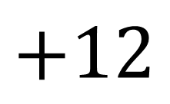

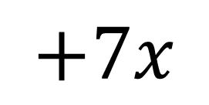
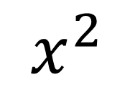
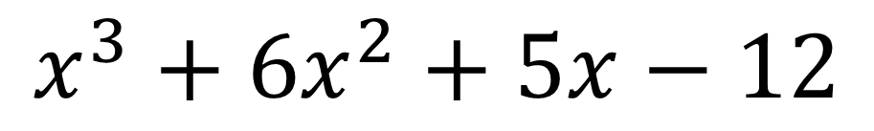
Fully factorise $x^{3}+6x^{2}+5x−12$
$$x^{2}$$
$$+7x$$
$$+12$$
$$x−1$$
$$x^{3}+6x^{2}+5x−12$$
$$x^{3}+6x^{2}+5x−12=\left(x−1\right)\left(x^{2}+7x+12\right) \\ =\left(x−1\right)\left(x+3\right)\left(x+4\right)$$

Slide 7

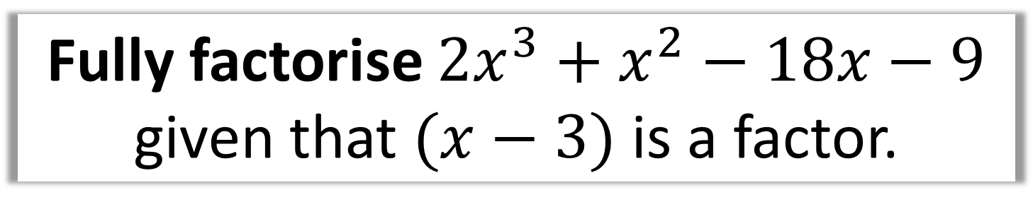
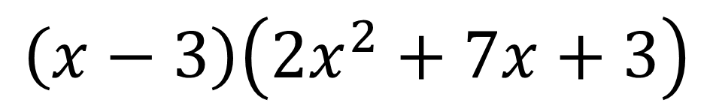
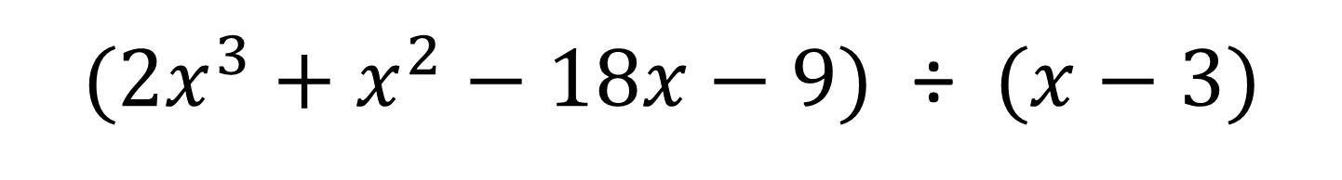
Fully factorise $2x^{3}+x^{2}−18x−9$
given that $(x−3)$ is a factor.
$(2x^{3}+x^{2}−18x−9)$ ÷$(x−3)$
Use long division to get
$$\left(x−3\right)\left(2x^{2}+7x+3\right)$$
Factorise the quadratic
$$=(x−3)(2x+1)(x+3)$$

